Slide 1
Dr.SNS RAJALAKSHMI COLLEGE OF ARTS & SCIENCE (Autonomous)
Coimbatore -641049
Accredited by NAAC(Cycle–III) with ‘A+’ Grade (Recognized by UGC, Approved by AICTE, New Delhi and
Affiliated to Bharathiar University, Coimbatore)
DEPARTMENT OF COMPUTER SCIENCE
COURSE NAME :21UCU403 OBJECT ORIENTED
PROGRAMMING
I YEAR /II SEMESTER
Unit 5-CLIENT SIDE ESSENTIALS
Topic 2:Accessing DOM Elements using JavaScript and jQuery
Objects ,Java Script Event Handling

Slide 2
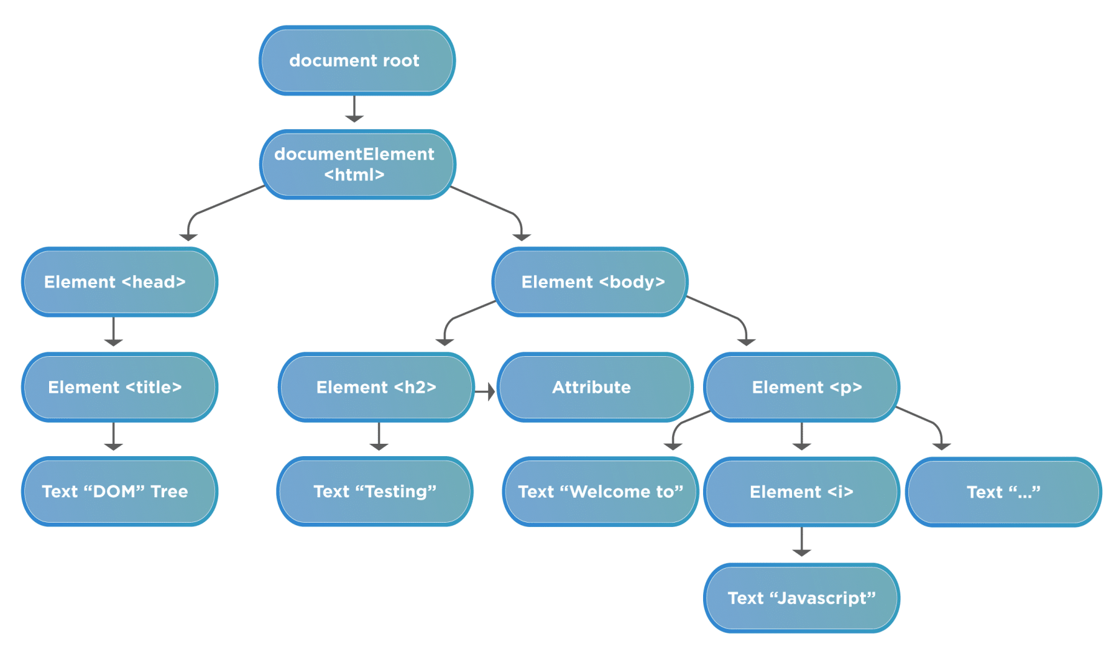
Accessing DOM Elements using JavaScript
What is DOM?
DOM is a data representation of the objects in the HTML and XML pages.
The document loaded in your browser is represented by a document object model.
It is a "tree structure" representation created by the browser that enables the HTML structure to be easily accessed by programming languages.
The DOM represents the document as nodes and objects.
5/3/2023
Accessing DOM Elements using JavaScript/21UCU403-Object oriented programming

Slide 3
DOM- Conti……
Terminologies related to DOM:
Element node
Root node
Child node
Descendant node
Parent node
Sibling nodes
Text node
5/3/2023
Accessing DOM Elements using Javascript/21UCU403-Object oriented programming

Slide 4
How to access DOM elements using JavaScript?
To access the DOM elements, JavaScript uses three ways:
First, Accessing elements By ID- "getElementById()"
Second, Accessing elements By TagName- getElementByTagName()
Third, Accessing elements By className- getElementByClassName()
5/3/2023
Accessing DOM Elements using JavaScript/21UCU403-Object oriented programming

Slide 5
Accessing DOM elements using jQuery Objects
A jQuery object is an array-like wrapper around one or more DOM elements.
The $ Symbol is used to access jQuery methods and functions.
jQuery provides several methods for accessing DOM elements, including $(), find(), children(), parent().
The $(document).ready() function is used to ensure that the DOM is fully loaded before executing jQuery code.
5/3/2023
Accessing DOM Elements using Jquery Objects/21UCU403-Object oriented programming

Slide 6
Accessing DOM elements using jQuery Objects- Conti…..
jQuery objects are created using the $ function followed by the selector string.
For example: var $myElement = $('#my-element');
To access the first element within a jQuery object, you can use the .first() method.
For example: $myElement.first() will give you the first element in the set.
To access the last element within a jQuery object, you can use the .last() method.
For example: $myElement.last() will give you the last element in the set.
5/3/2023
Accessing DOM Elements using jquery Objects/21UCU403-Object oriented programming
Accessing DOM Elements using Jquery Objects/21UCU403-Object oriented programming

Slide 7
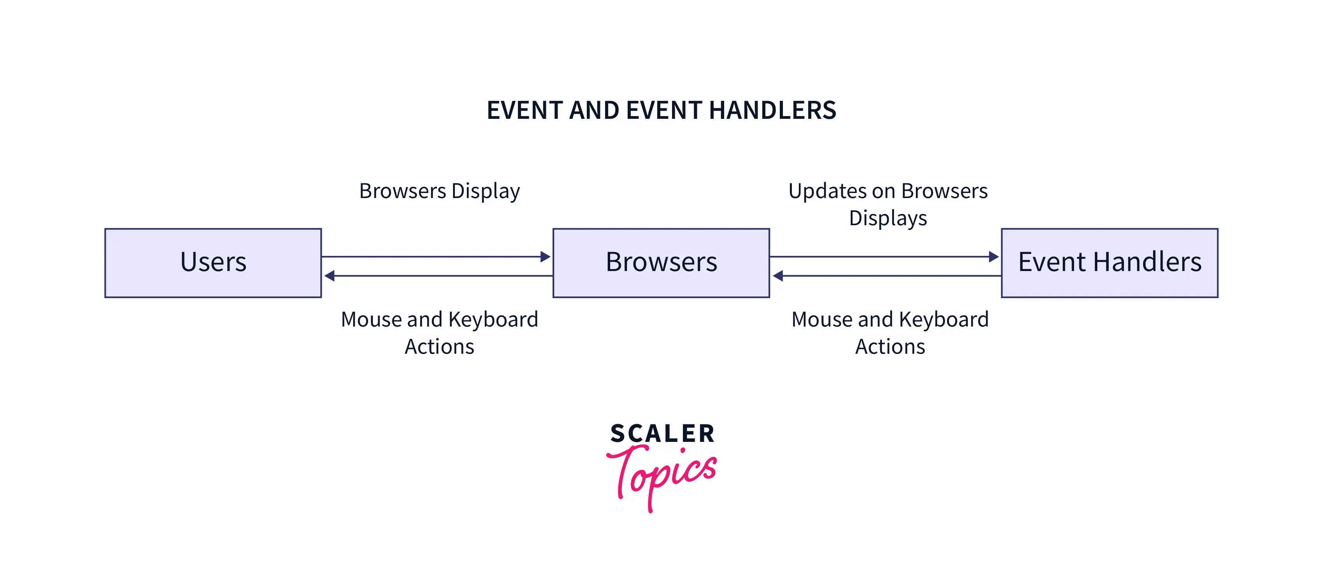
JavaScript Event Handling
The change in the state of an object is known as an Event.
Event Handling is the mechanism that controls the event and decides what should happen if an event occurs. This mechanism have the code which is known as event handler that is executed when an event occurs.
The process of reacting over the events is called Event Handling. Thus, is handles the HTML events Event Handlers.
5/3/2023
JavaScript event handling/21UCU403-Object oriented programming

Slide 8
Types of Event
The events can be broadly classified into two categories:
Foreground Events - Those events which require the direct interaction of user. They are generated as consequences of a person interacting with the graphical components in Graphical User Interface.
For example, clicking on a button, moving the mouse, entering a character through keyboard, selecting an item from list, scrolling the page etc.
Background Events - Those events that require the interaction of end user are known as background events. Operating system interrupts, hardware or software failure, timer expires, an operation completion are the example of background events.
5/3/2023
JavaScript event handling/21UCU403-Object oriented programming

Slide 9
Assessment-1
Explain about JavaScript event handling?
How to Access DOM Elements using JavaScript and jQuery?
5/3/2023
JavaScript event handling/21UCU403-Object oriented programming

Slide 10
References
The Complete Reference ,JAVA, McGraw-Hill education ;Tenth edition ,ISBN 10;1259589331,9781259589331.
Thank You
5/3/2023

