Slide 1
Business Intelligence
Prepared By
Dr.A.DEVI
Associate Professor
Department of Computer Applications

Slide 2
Business Analytics, BI, Big Data, Data Mining - What’s the difference?
Business Analytics – Tools to explore past data to gain insight into future business decisions.
BI – Tools and techniques to turn data into meaningful information.
Big Data –data sets that are so large or complex that traditional data processing applications are inadequate.
Data Mining - Tools for discovering patterns in large data sets.

Slide 3
Characteristics of Data for Good Decision Making

Slide 4
The Information Gap
The shortfall between gathering information and using it for decision making.
Firms have inadequate data warehouses.
Business Analysts spend 2 days a week gathering and formatting data, instead of performing analysis. (Data Warehousing Institute).
Business Intelligence (BI) seeks to bridge the information gap.

Slide 5
Data Mining
“Data mining is an interdisciplinary subfield of computer science. It is the computational process of discovering patterns in large data sets involving methods at the intersection of artificial intelligence, machine learning, statistics, and database systems.”
Examining large databases to produce new information.
Uses statistical methods and artificial intelligence to analyze data.
Finds hidden features of the data that were not yet known.

Slide 6
What is Business Intelligence?
Collecting and refining information from many sources (internal and external)
Analyzing and presenting the information in useful ways (dashboards, visualizations)
So that people can make better decisions
That help build and retain competitive advantage.

Slide 7
BI
Tools and techniques to turn data into meaningful information.
Process: Methods used by the organization to turn data into knowledge.
Product: Information that allows businesses to make decisions.

Slide 8
BI Applications
Customer Analytics
Human Capital Productivity Analysis
Business Productivity Analytics
Sales Channel Analytics
Supply Chain Analytics
Behavior Analytics

Slide 9
Klipfolio - sample of a marketing dashboard

Slide 10
FitBit – Health Dashboard

Slide 11
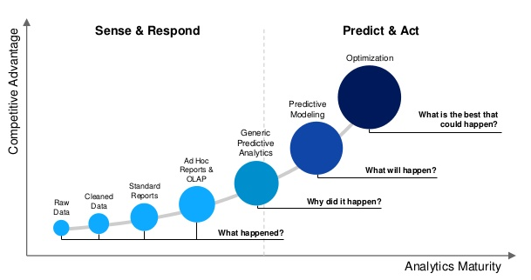
Evolution of BI

Slide 12
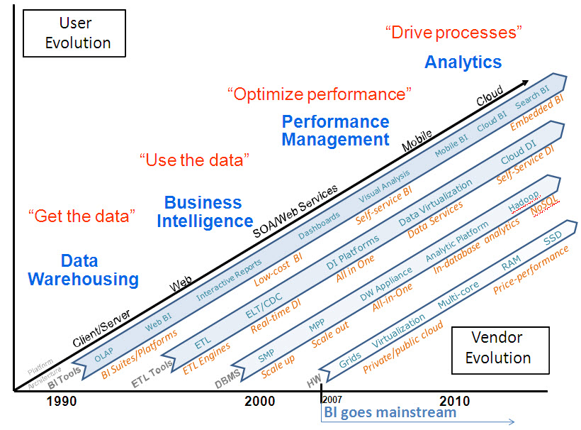
Evolution of BI (contd.)

Slide 13
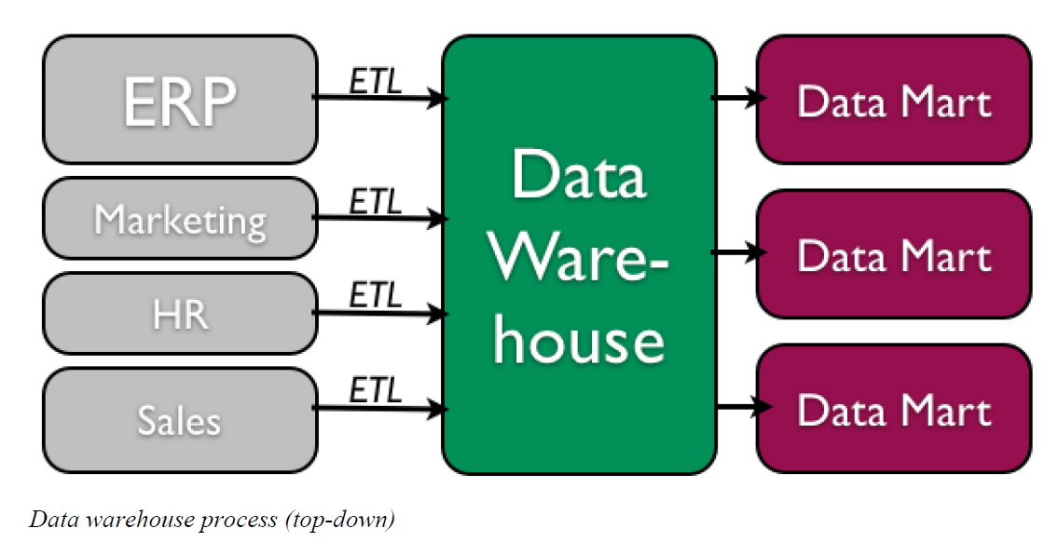
Data Warehouse
Collection of data from multiple sources (internal and external)
Summary, historical and raw data from operations.
Data “cleaning” before use.
Stored independently from operational data.
Broken down into DataMarts for use.

Slide 14
5 Tasks of Data Mining in Business
Classification – Categorizing data into actionable groups. (ex. loan applicants)
Estimation – Response rates, probabilities of responses.
Prediction – Predicting customer behavior.
Affinity Grouping – What items or services are customers likely to purchase together?
Description – Finding interesting patterns.

Slide 15
Data Mining Techniques
Market Basket Analysis
Cluster Analysis
Decision Trees and Rule Induction
Neural Networks

Slide 16
Market Basket Analysis
Finding patterns or sequences in the way that people purchase products and services.
Walmart Analytics
Obvious: People who buy Gin also buy tonic.
Non-obvious: Men who bought diapers would also purchase beer.

Slide 17
Cluster Analysis
Grouping data into like clusters based on specific attributes.
Examples
Crime map clusters to better deploy police.
Where to build a cellular tower.
Outbreaks of Zika virus.

Slide 18
Thank you

