Slide 1
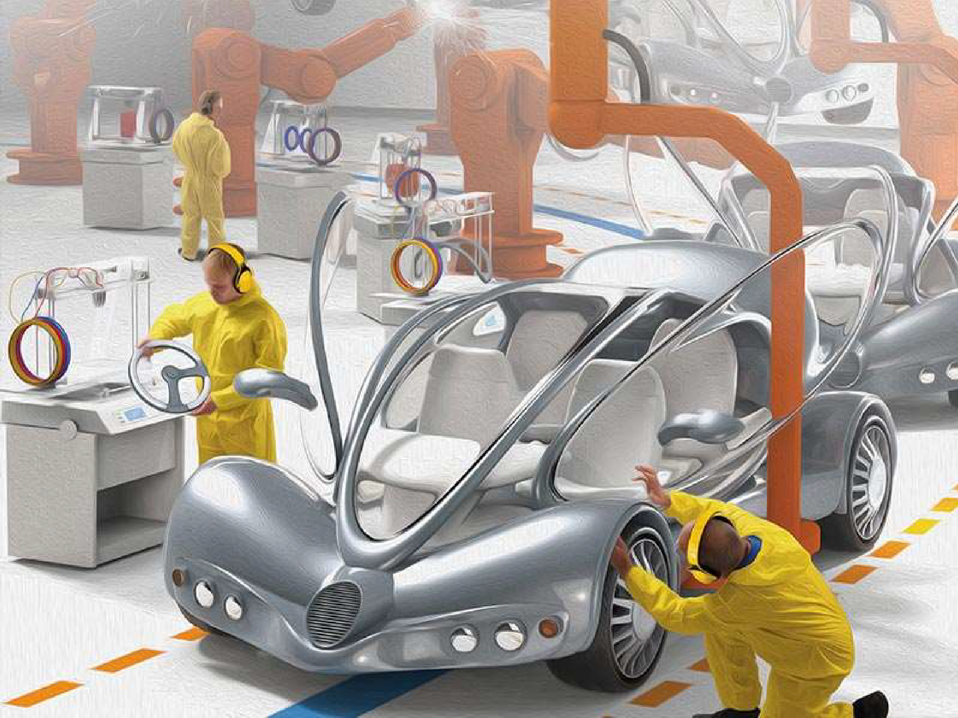

Slide 2
Example:
☞
☞
Cloth from cotton Sugar from sugarcane Paper from wood
Iron from iron ore
☞
☞

Slide 3
■
■
■
■
■
■

Slide 6
On the basis of

Slide 7
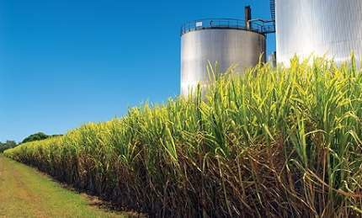
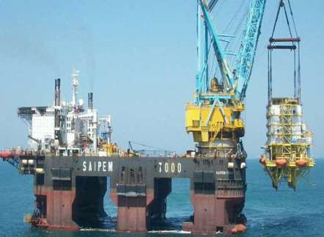
Use agricultural raw
materials
Cotton, wool, jute, silk textile, rubber and sugar, tea, coffee etc..
Use minerals as raw materials.
Iron and steel, cement, aluminum, machine tools etc…

Slide 8
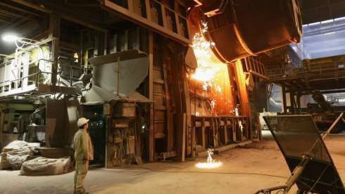
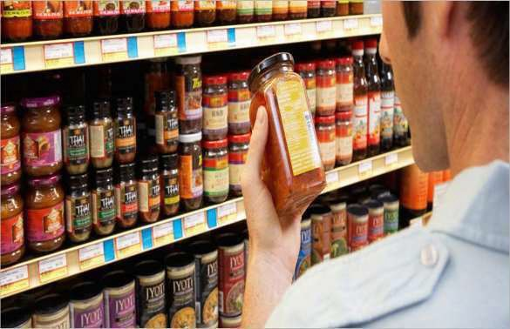
Basic/key industries:
Consumer Industries:
Supply their products or raw materials to manufacture other goods.
E.g.: iron and steel and copper smelting, aluminum smelting.
Produce goods for direct use by
consumers
E.g.: sugar, toothpaste, paper, fans etc…

Slide 9
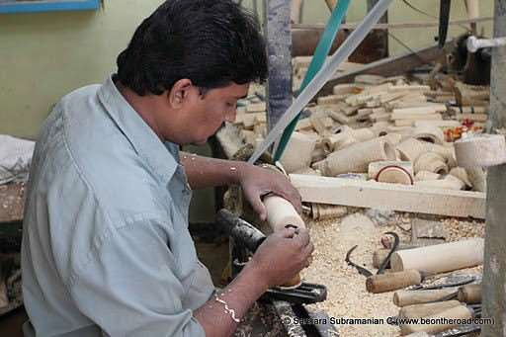
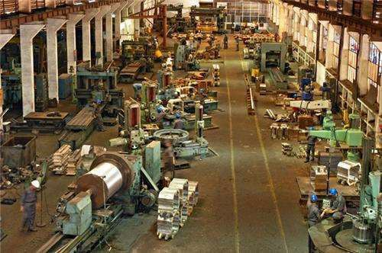
Small scale Industries:
large scale Industries:
maximum investment is allowed on assets of unit.
Run by less number of people.
E.g. khandasari, gur etc…
If the investment is more than one crore, then it is known as large scale industry.
Labours are more.
E.g.: cotton textile industry

Slide 10
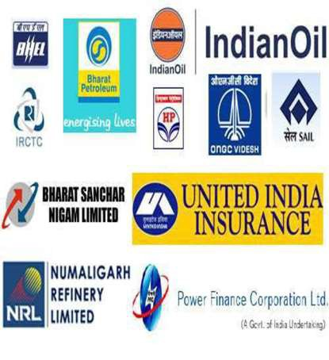
Public Sector:
Private Sector:
Owned and operated by individuals or a group of individuals.
E.g.: TISCO, Bajaj Auto Ltd. Dabur industries.
Owned and operated by government agencies.
E.g.: BHEL, SAIL
etc…

Slide 11
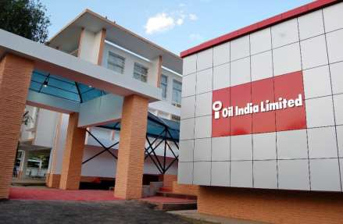
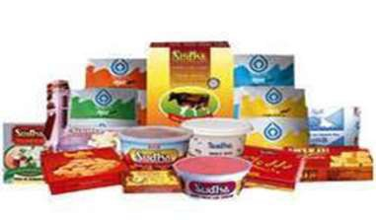
Industries are owned and operated by the producers or suppliers of raw materials, workers or both.
They pool in the resources and share the profits or losses proportionately
E.g.: sugar industry in Maharashtra, the coir industry in Kerala
The industries which are jointly run by the state and individuals or a group of individuals.
E.g.: Oil India Limited[OIL] is jointly owned by public and private sector.

