Slide 1
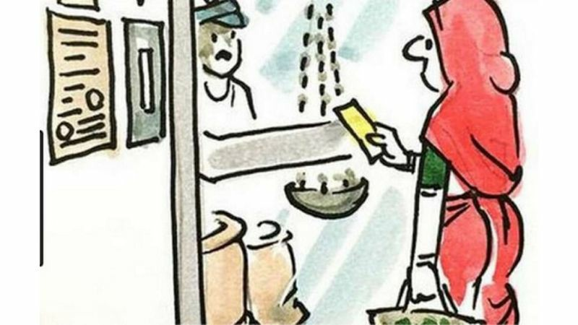
DEMAND

Slide 2
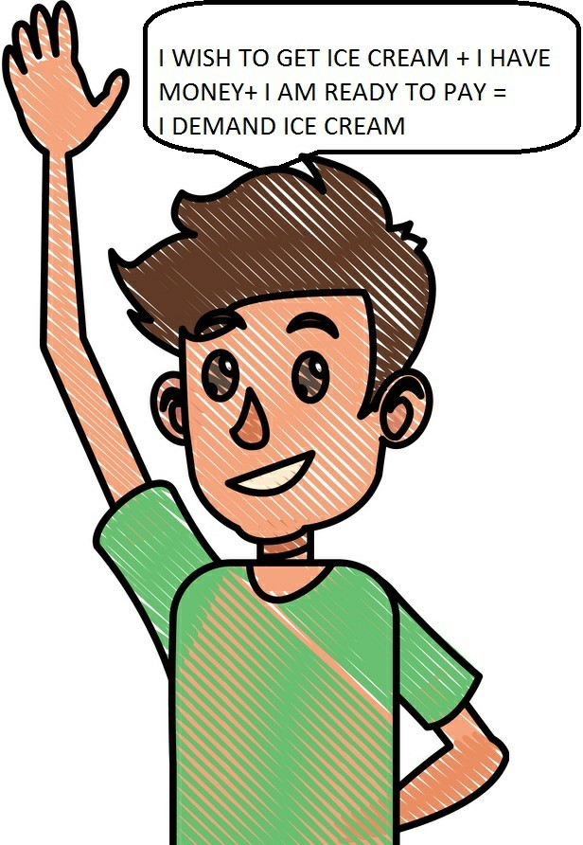
Demand is a desire backed by ability to pay and willingness to pay.

Slide 3
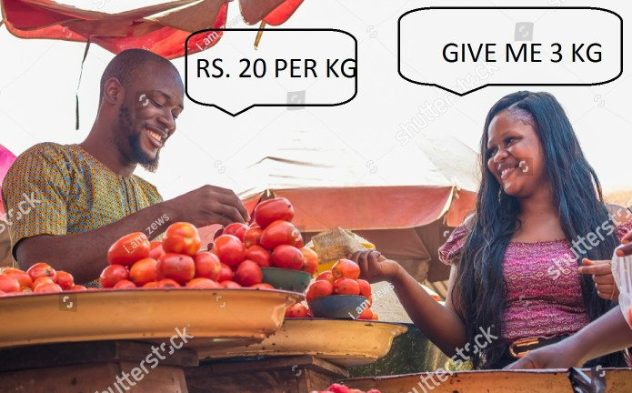
Demand for a commodity refers to the quantity of a commodity which a consumer is willing to buy at a given price and in a given period of time.

Slide 4
LAW OF DEMAND
OR
MOVEMENT ALONG THE SAME DEMAND CURVE
OR
EXTENSION AND CONTRACTION OF DEMAND
OR
CHANGE IN QUANTITY DEMANDED
EXTENSION AND CONTRACTION OF DEMAND

Slide 5
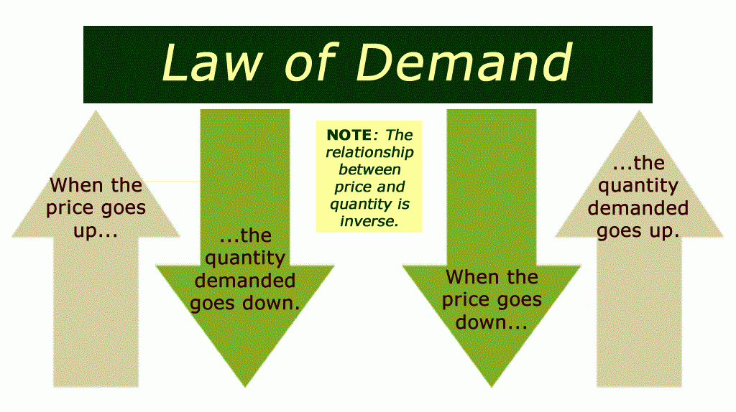
LAW OF DEMAND
Other things remaining the same, when the price of a commodity falls, demand for it expands, and when the price rises demand contracts.

Slide 6
ASSUMPTIONS OF THE LAW OF DEMAND
The consumer is rational.
There is no change in the price of related goods.
Tastes and preferences of the consumer remain same.
Population remains constant.
There are no expectations about changes in future prices

Slide 7
DEMAND SCHEDULE
It is a tabular presentation that shows the relationship between quantity demanded and
price.
PRICE
QUANTITY DEMANDED
PRICE
QUANTITY
DEMANDED
50
1
50
1
40
2
40
2
30
3
30
3
20
4
20
4

Slide 8
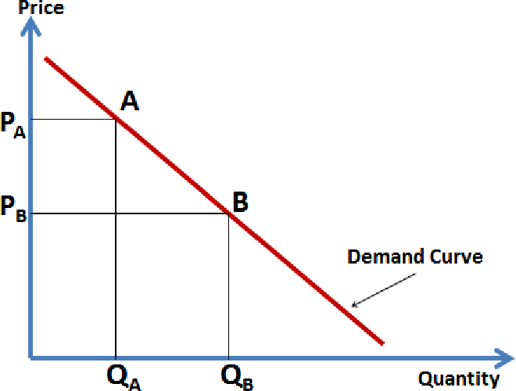
Demand Curve

Slide 9
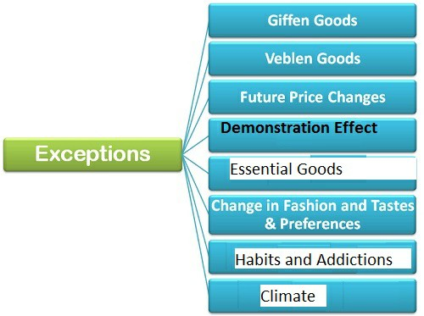
EXCEPTIONS TO THE LAW OF DEMAND

Slide 10
1. GIFFEN GOODS
They are inferior goods.
The demand for Giffen’s goods contracts when their prices fall.
It is because people substitute them with superior goods.
2. DEMONSTRATION EFFECT
It means copying the acts of others.
Some people buy more units of a commodity even when their prices are rising just because others are buying it. It is called Demonstration Effect.

Slide 11
3. HABITS AND ADDICTIONS
If a person is addicted to a commodity, he will not reduce the consumption of it even if the price rises.
For example, a smoker may not reduce the consumption of cigarettes, even if the cigarette price is rising.
4. ESSENTIAL GOODS
Increase or decrease in the prices of essential goods like medicines do not affect their demand.

Slide 12
VEBLEN’S EFFECT
Some people buy more of a commodity, even when their prices are rising just to maintain social status and prestige.
CLIMATE
The demand for woolen clothes increase in winter even if there is no change in price.

Slide 13
REASONS BEHIND THE LAW OF DEMAND
(Reasons behind the downward slope of demand curve
Only a downward sloping curve can show the inverse relationship between price and quantity demanded.
When price falls old buyers will buy more quantity. New buyers will start buying.
When price falls, people may ﬁnd new uses for the commodity.
Rational consumers will reduce the quantity demanded when the price rises in order to equalise price with marginal utility.
Fall in price leads to increase in real income. Consumer can buy more with the given money income

Slide 14
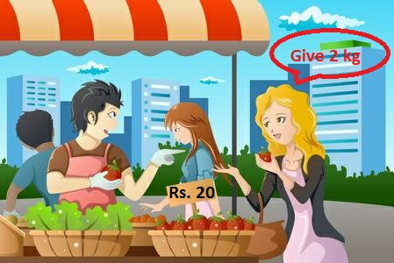
Individual Demand

Slide 15
INDIVIDUAL DEMAND
It refers to the quantity of a commodity which an individual consumer is willing to buy at a given price and in a given period of time.
PRICE | QUANTITY DEMANDED
50 | 1
40 | 2
30 | 3
20 | 4
10 | 5

Slide 16
INDIVIDUAL DEMAND CURVE

Slide 17
MARKET DEMAD = HORIZONTAL SUMMATION OF INDIVIDUAL DEMANDS
2Kg
1Kg
4K G
MARKET DEMAND = 2 + 1
+ 4 = 7 Kg

Slide 18
MARKET DEMAND
It is the sum total of the quantities of a commodity demanded by all the consumers in a market at a given price and in a given period
of time.
PRICE | QUANTITY DEMANDE D BY A | QUANTITY DEMANDE D BY B | QUANTITY DEMANDE D BY C | MARKET DEMAND
10 | 5 | 4 | 3 | 12
8 | 8 | 6 | 5 | 19
6 | 12 | 10 | 8 | 30
2 | 15 | 12 | 10 | 37

Slide 19
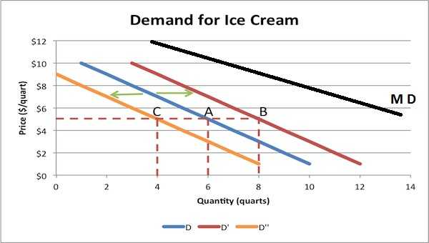
Market Demand Curve (MD) is flatter than Individual demand Curves (C,A,B) because Market Demand is the horizontal summation of individual demands.

Slide 20
CHANGE IN DEMAND
CHANGE IN QUANTITY DEMANDED
Rise or fall in demand due to factors other than price.
Rise or fall in price due to change in price
Rise in demand is called Rise in demand is called increase in demand and fall extension or expansion in
in demand is called decrease in demand
demand and fall in demand is called contraction in demand.
The demand curve will shift There is only a single
to the right in case of increase in demand and to the left in case of decrease in demand.
demand curve. There will be rightward movement during expansion and leftward movement during contraction on the same

Slide 22
INCOME: In the case of normal goods increase in income leads to increase in demand. In the case of inferior goods, increase in income leads to decrease in demand.
CHANGE IN TASTES HABITS AND FASHION: This
will also lead to change in demand.
Example: Students a days prefer ball point pens.
So, the demand for ball point pens is increasing and the demand for ink fountain pen is decreasing

Slide 23
PRICE OF RELATED GOODS: Substitute Goods and Complementary Goods are related Goods
In the case of substitute goods, the increase in the price of one good will lead to increase in the demand for the other good.
For Example: Tea and Coffee are substitute goods. If the price of tea rises, people will substitute tea with coffee. So, demand for coffee will increase.
In the case of complementary goods, the rise in the price of one good will lead to fall in the demand for the other good.
For example: Car and Petrol are complementary goods. Rise in the price of car will lead to fall in the demand for petrol.

Slide 24
POPULATION: Increase in population leads to increase in demand for goods and services and decrease in population leads to decrease in demand for goods and services.
CREDIT FACILITIES: If banks offer loans for purchasing costly goods like cars, their demand will increase. Absence of credit facilities may lead to fall in demand for costly goods.

Slide 25
NORMAL GOODS Vs INFERIOR GOODS

Slide 26
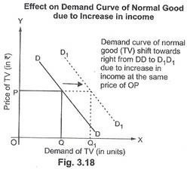
NORMAL GOODS ARE INCOME POSITIVE

Slide 27
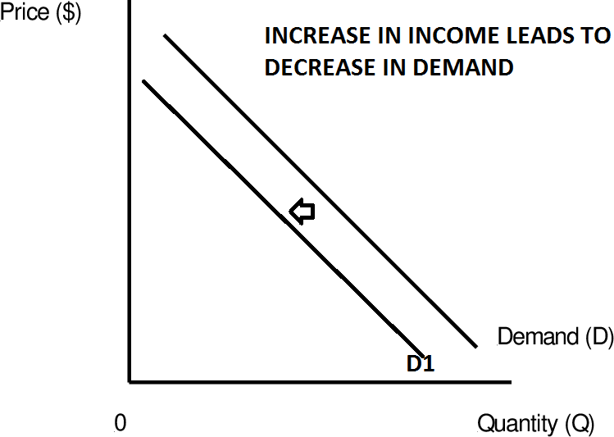
INFERIOR GOODS ARE INCOME
• NEGATIVE

