Slide 1
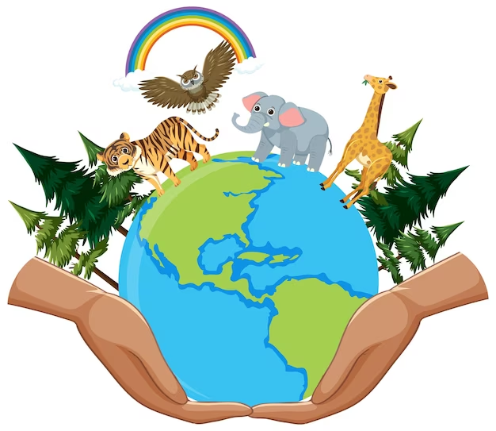
RESPECTING OUR WORLD

Slide 2
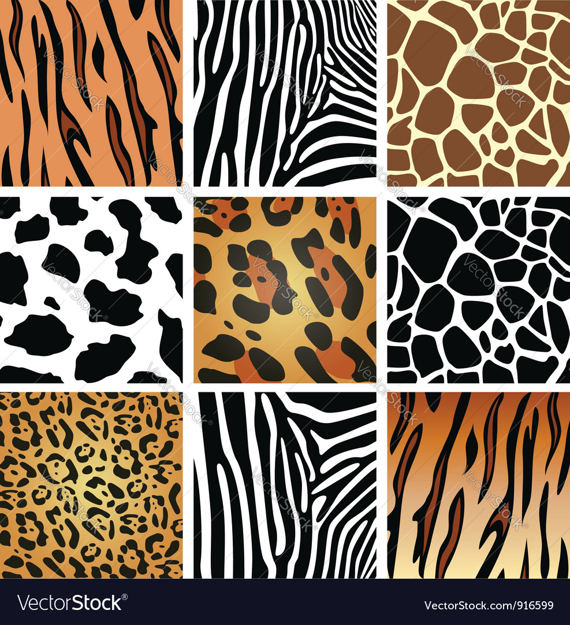
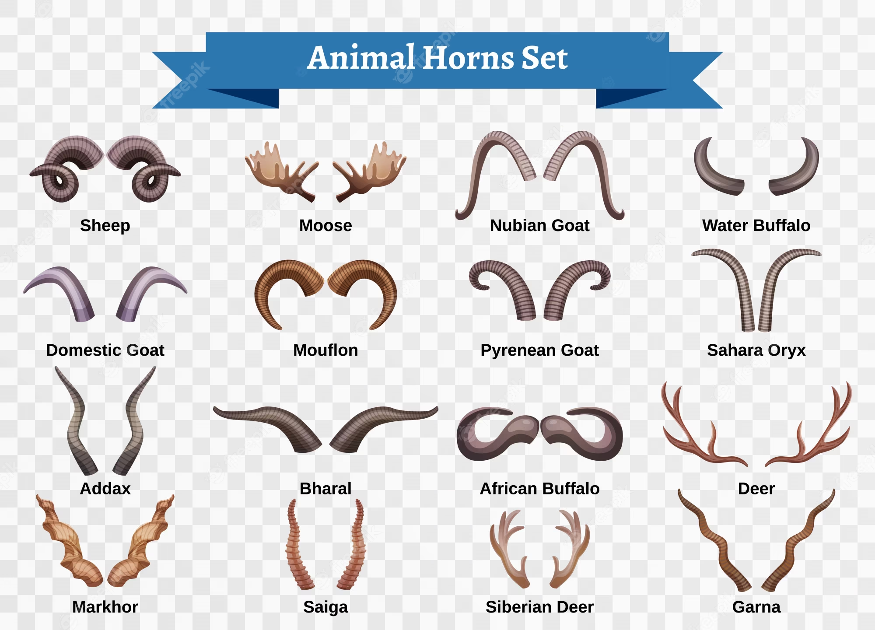
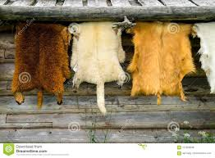
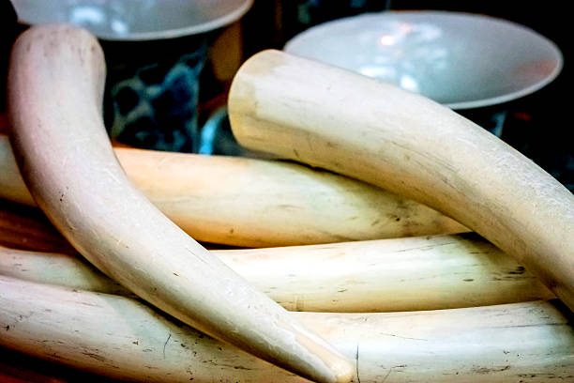
To protect animals from poaching
Skin
Fur
Tusk
Horns

Slide 3
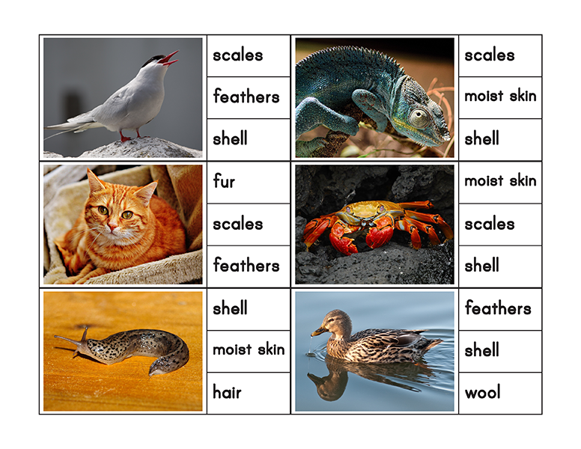
Animals with different body coverings

Slide 4
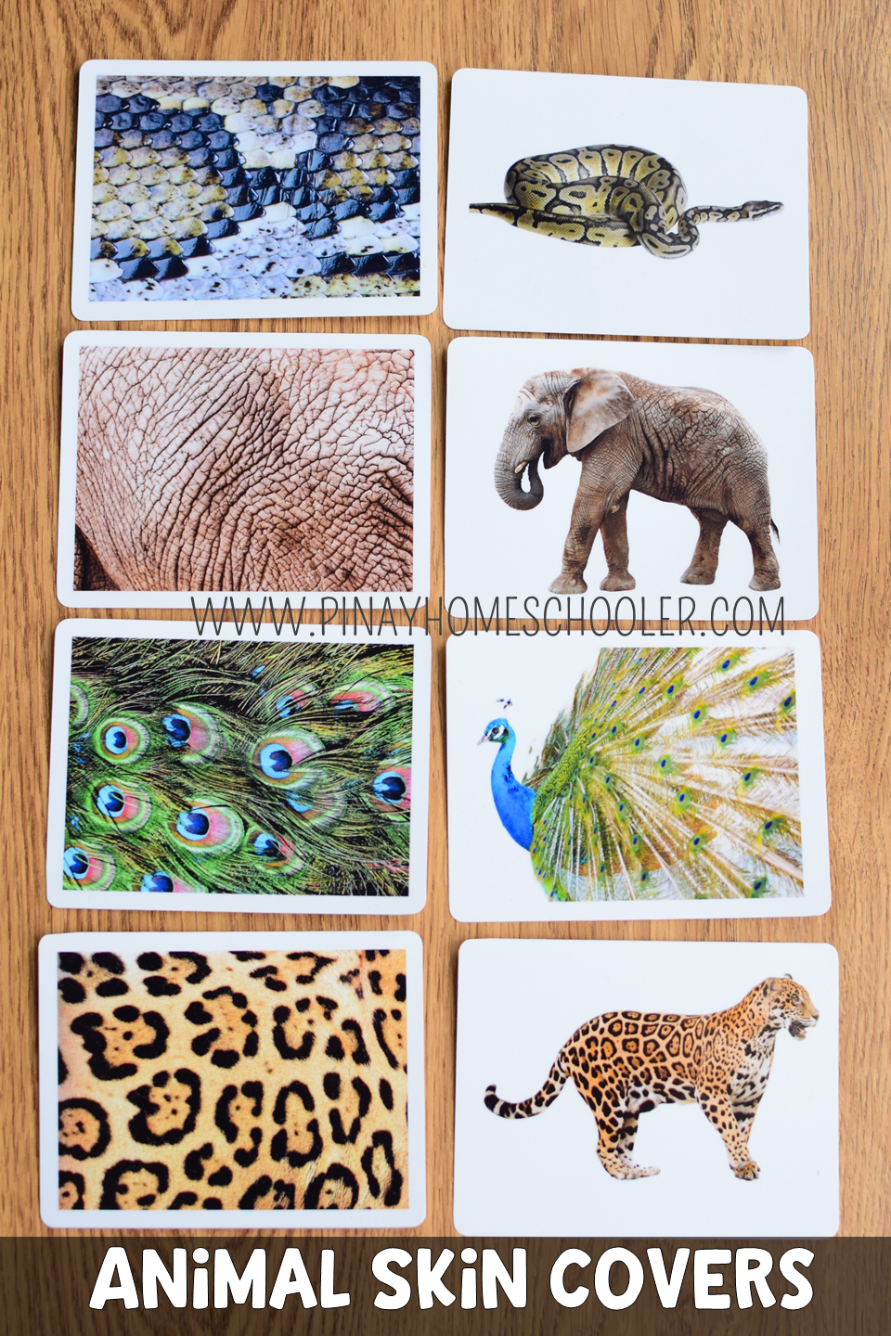
SKIN
Animal skins have long been valued particularly as raw materials for clothing (leather and wool), gloves (leather), shoes (leather), furniture (leather), blankets (wool), and other uses.

Slide 5
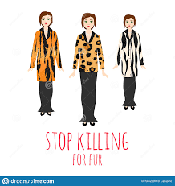
FUR
Fur is a thick growth of hair that covers the skin of mammals. It consists of a combination of oily guard hair on top and thick underfur beneath. The guard hair keeps moisture from reaching the skin; the underfur acts as an insulating blanket that keeps the animal warm.

Slide 6
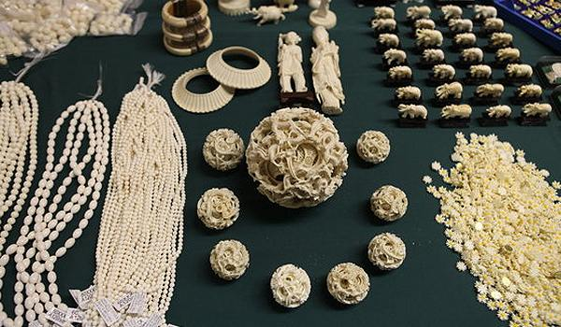
TUSK
Their tusks are actually teeth
Elephant tusks are actually enlarged incisor teeth which first appear when elephants are around 2 years old.
Tusks continue growing throughout their lives. Tusks are used to help with feeding - prising bark off trees or digging up roots - or as a defense when fighting.

Slide 7
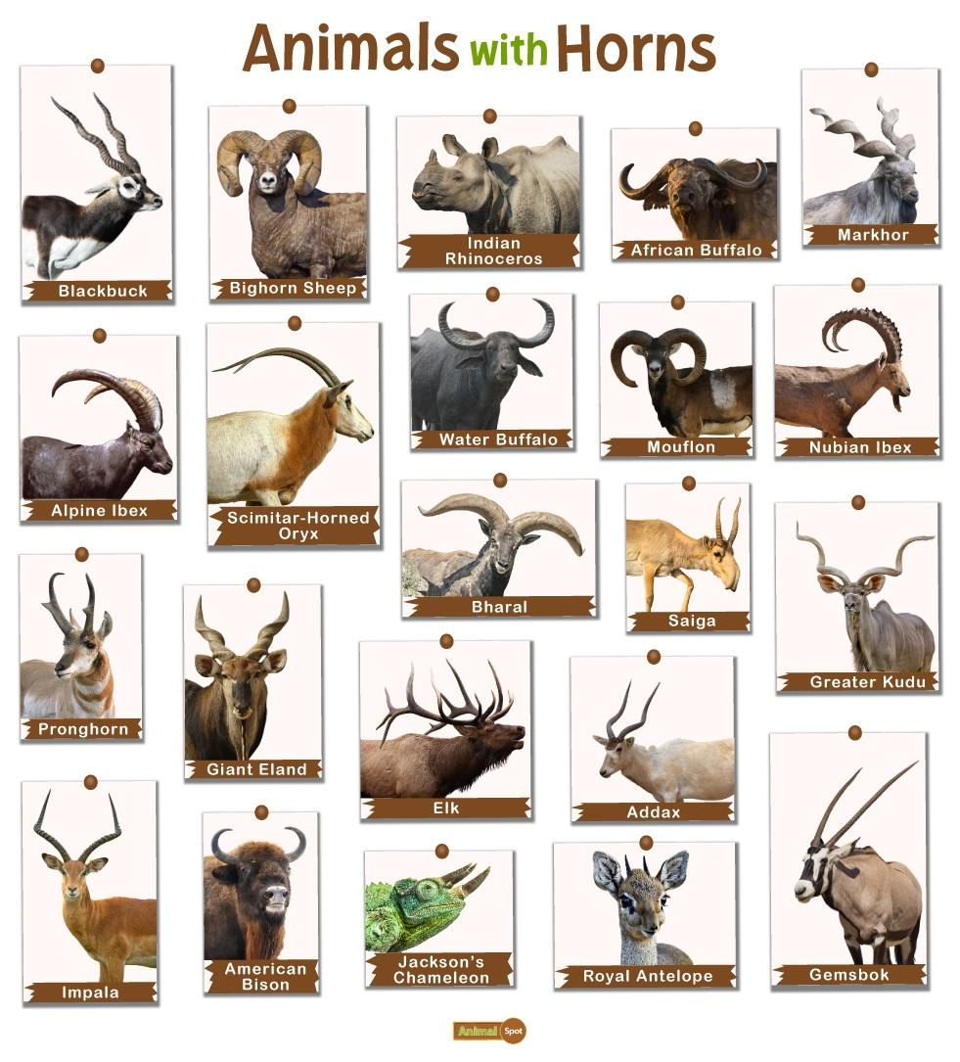
HORNS
Horns are composed of a bony core covered with a sheath of keratin. Unlike antlers, horns are never branched, but they do vary from species to species in shape and size. The growth of horns is completely different from that of antlers.
Horn may be used as a material in tools, furniture and decoration, among other uses

