Slide 1
TITLE SLIDE

Slide 2
CONTENT SLIDE

Slide 3
CONTENT SLIDE

Slide 4
QUESTIONS RELATED TO ABOVE SLIDES

Slide 5
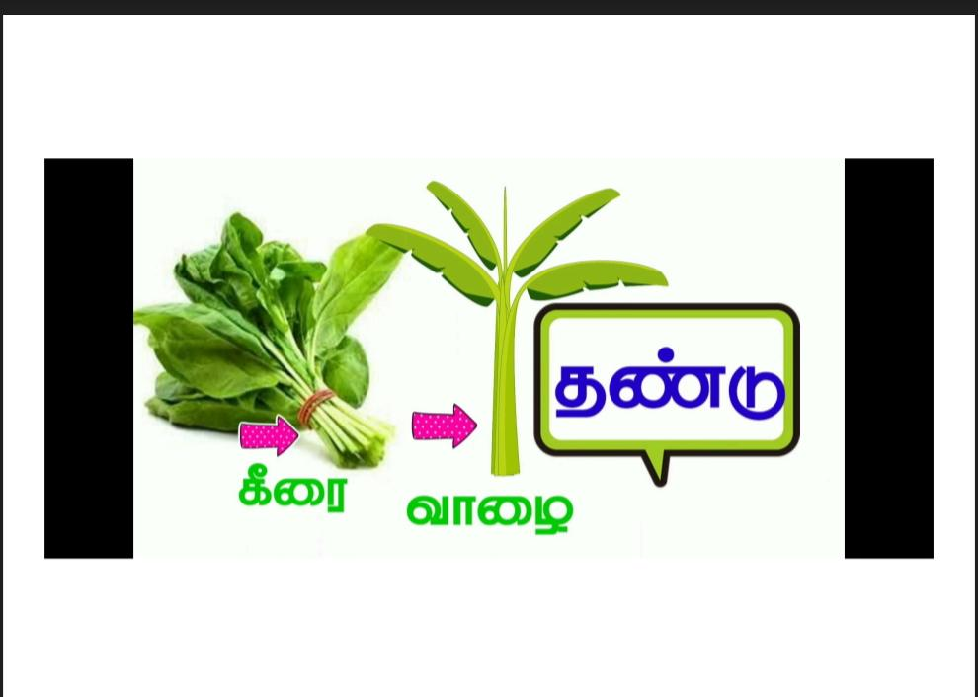
CONTENT SLIDE

Slide 6
CONTENT SLIDE

Slide 7
CONTENT SLIDE

