Slide 2
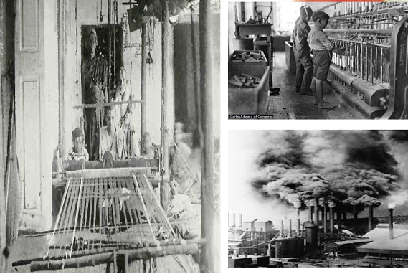
INDUSTRIAL SECTOR

Slide 3
Main features of India’s industrial sector on the eve of Independence
(i) The British followed a policy of ‘de – industrialization’ in India. Their aim was to use India as a market for their finished goods and as a source of raw materials to feed their industries.
(ii) The Indian traditional handicraft industry declined. The Indian goods lost their domestic and international demand

Slide 4
(iii) Growth of modern industries was very slow in India. The government did not take any step for industrial development.
(iv) The role of public sector was limited to railways, power generation, communication and ports.
(v) Capital goods industries did not come up in India. We had to import all machines and tools from

Slide 5
Factors Responsible for the decline of Indian handicrafts industries(Cottage and village industries)
(i) Discriminatory Tariff Policy: The British Government imposed heavy export duty on Indian goods. The raw materials were exempted from export duty. At the same time the government allowed duty free import of foreign goods in to India. This policy helped the British Industries.
(ii) Competition from British Goods: Low cost and better finished British goods were imported to India on a large scale. So, our goods faced stiff competition in the markets.

Slide 6
(iii) Loss of International Demand: European countries made laws to prevent the entry of Indian goods in to their markets. They imposed heavy import duty on Indian goods. So, our goods lost their international market.
(iv) New Pattern of Demand: The middle class was influenced by western culture. They favoured British goods.
(v) Introduction of Railways: The railway network helped the British to take their goods even to the interior parts of India. Thus, Indian goods faced competition even in remote areas.
(vi) Loss of Patronage: The end of the rule of Kings and Nawabs resulted in the loss of patronage to Indian handicrafts.

Slide 7
FOREIGN TRADE
(i) The British established monopoly over India’s foreign trade. More than half of our trade was with Britain. Other trading partners were China, Srilanka and Persia.
(ii) Before the colonial period, India was a major exporter of finished goods. The British rule converted India in to an exporter of raw materials and an importer of finished goods.
(iii) India exported primary products like raw silk, cotton, sugar, indigo, jute etc. We imported cotton, silk and jute clothes and capital goods.
(Iv) India’s balance of trade was favourable. There was export surplus.

Slide 8
INDIA’S BALANCE OF TRADE
India’s balance of trade was favourable. There was export surplus. The export surplus did not bring gold or silver to India. It did not benefit India because:
(i) the surplus was used to maintain the office set up by the colonial Government in Britain
(ii) to meet the war expenditure.
(iii) to import invisible items.

