Slide 1
HYDROCARBONS
Hydrocarbons are organic compounds that consist of only C and H atoms.
Hydrocarbons come in a variety of forms. They may be gases (methane and paropane), liquids (hexane and benzene), waxes (paraffin wax), or polymers (polyethylene and polystyrene).
Hydrocarbons can be processed to create plastics.
They are insoluble in water.

Slide 2
HYDROCARBONS
The simplest class of organic compounds.
Nonpolar
There are four main types of hydrocarbons:
- saturated hydrocarbons (alkanes)
- unsaturated hydrocarbons (alkenes or alkynes)
- cycloalkanes
- aromatic hydrocarbons

Slide 3
HYDROCARBONS
SATURATED means that each carbon is bonded to four other atoms through single covalent bonds. Hydrogen atoms usually occupy all available bonding positions after the carbons have bonded to each other.
UNSATURATED hydrocarbons contain either double or triple bonds. Since the compound is unsaturated with respect to hydrogen atoms, the extra electrons are shared between 2 carbon atoms forming double or triple bonds.

Slide 4
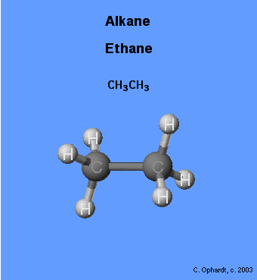
ALKANES
made up of only carbon and hydrogen atoms
Also called “paraffins”
single bonds only between carbon atoms
general formula: C_{n}H_{2n+2} (assuming non-cyclic structures)
name ends in "ane"

Slide 5
IUPAC name | Molecular Formula | Structural Formula | Boiling Point (°C) | Melting Point (°C) | Density (g/ml, 20°C)
Methane | CH₄ | CH₄ | -161.5 | -182.5
Ethane | C₂H₆ | CH₃CH₃ | -88.6 | -183.3
Propane | C₃H₈ | CH₃CH₂CH₃ | -42.1 | -189.7
Butane | C₄H₁₀ | CH₃(CH₂)₂CH₃ | -0.5 | -138.4
Pentane | C₅H₁₂ | CH₃(CH₂)₃CH₃ | 36.1 | -129.7 | 0.626
Hexane | C₆H₁₄ | CH₃(CH₂)₄CH₃ | 68.7 | -95.3 | 0.659
Heptane | C₇H₁₆ | CH₃(CH₂)₅CH₃ | 98.4 | -90.6 | 0.684
Octane | C₈H₁₈ | CH₃(CH₂)₆CH₃ | 125.7 | -56.8 | 0.703
Nonane | C₉H₂₀ | CH₃(CH₂)₇CH₃ | 150.8 | -53.5 | 0.718
Decane | C₁₀H₂₂ | CH₃(CH₂)₈CH₃ | 174.1 | -29.7 | 0.730

Slide 6
Alkanes
Many of these (alkanes) substances are familiar because of their widespread use.
Example: Methane (CH₄ ), a major component of natural gas
- propane (C₃H₈), major component of bottled gas
- butane (C₄H₁₀), used in disposable lighters and in fuel canisters for gas camping stoves and lanterns.
- alkanes with from 5 to 12 carbon atoms per molecule are found in gasoline.

Slide 7
Important Families of Organic Compounds
Hydrocarbons Alkanes Alkenes | Only C and H present Single bond Double bond
Alkynes Aromatic Alcohols | Triple bond R O H
Ethers Aldehydes | R O R’ O R C H
Ketones | O R C R
Esters | O R C OR

Slide 8
Carboxylic acids | O R C OH
Amines | R’’(H) R N R’(H)
Amides | O R R C N R

Slide 9
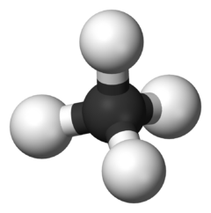
Organic chemistry
The study of carbon compounds
The first known organic compounds were derived from animal and vegetable sources and were difficult to crystallize and purify.
Swedish chemist Torbern Bergman was the first person to express the difference between “organic” and “inorganic” substances, and the phrase organic chemistry soon to came to mean “the chemistry of compounds from living organisms”.

Slide 10
Organic Chemistry
To many chemist at that time, their only explanation for the difference in behavior between organic and inorganic compounds was that organic compounds contained a peculiar and “vital force” (vital force theory) as a result of their derivation from living sources.
Michel Chevreul (1816)
Animal fat ^{NaOH} soap + Glycerine
Soap H₃O⁺ “fatty acids”

Slide 11
Why is Carbon special? Why is it that sets Carbon apart from all other elements in the periodic table?
-The unique ability of carbon to bond together forming long chains and rings. Carbon, alone of all elements, is able to form an immense diversity of compounds, from the simplest to the staggeringly complex: from methane to DNA, which can contain hundreds of billions.

