Slide 1
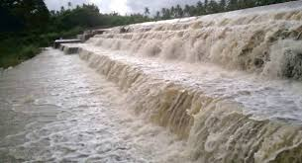
DRAINAGE Class 9

Slide 2
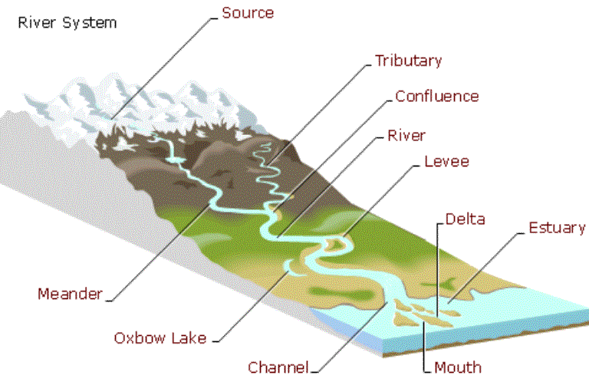
The term drainage describes the river system of an area.

Slide 3
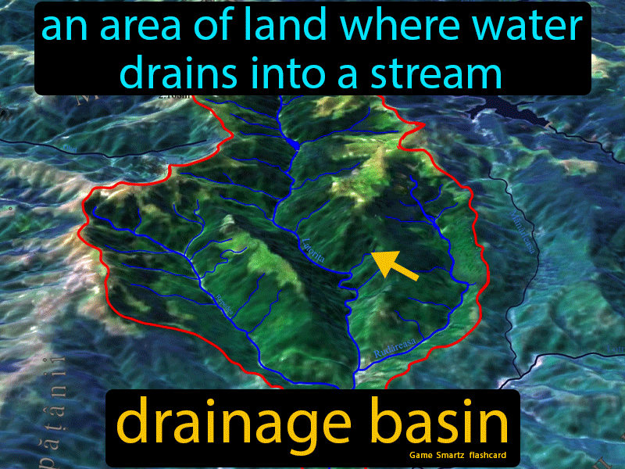
The area drained by a single river system is called a drainage basin.

Slide 4
A mountain or a upland area separating two drainage basins is called water divide.

Slide 5
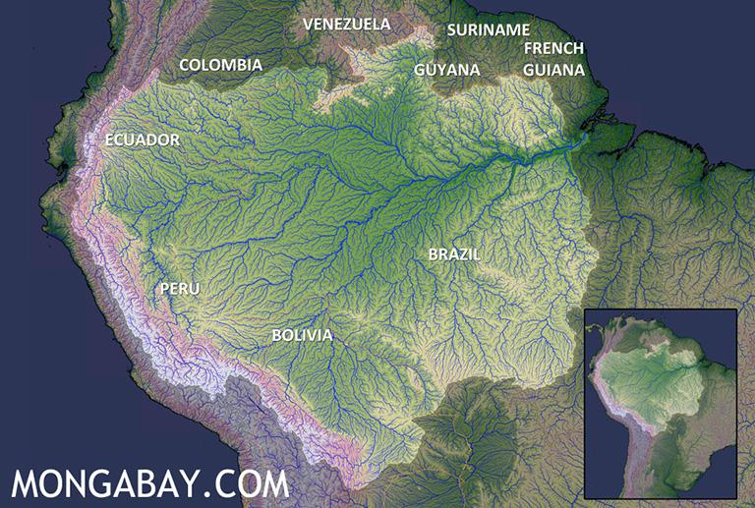
The world’s largest drainage basin is of the Amazon river
.

Slide 6
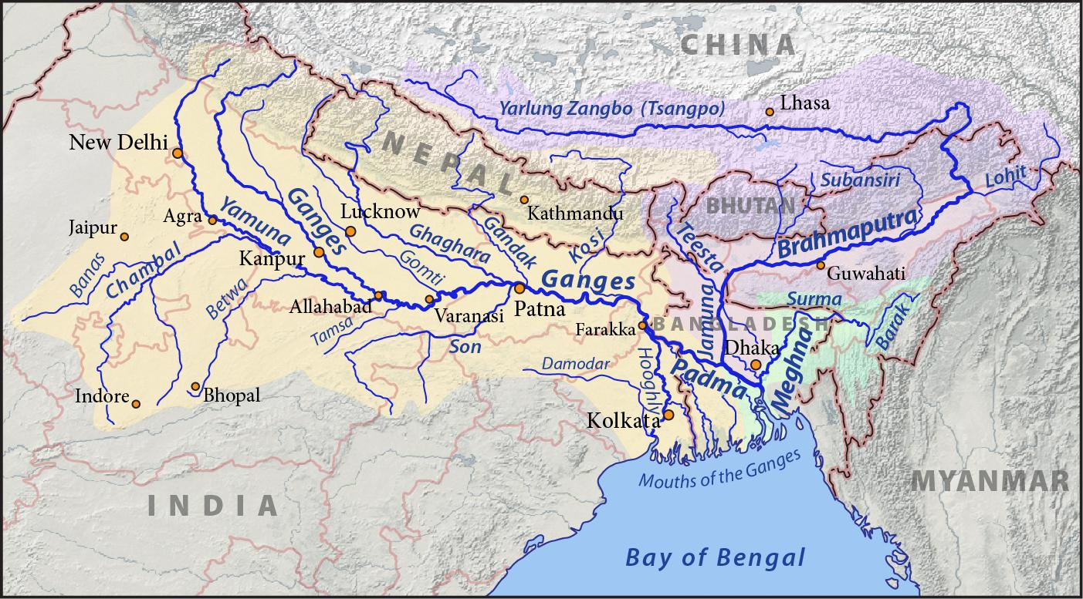
India’s largest drainage basin is of the Ganga river.

Slide 7
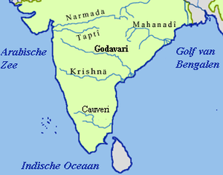
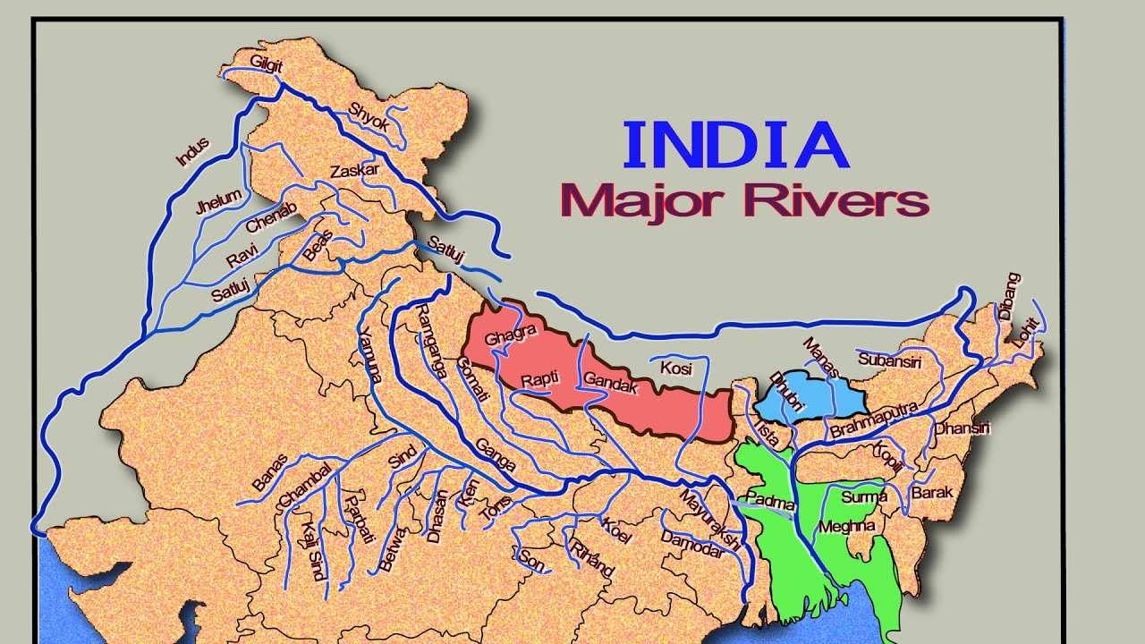
Drainage Systems in India
The Himalayan river system
The Peninsular river system

Slide 8
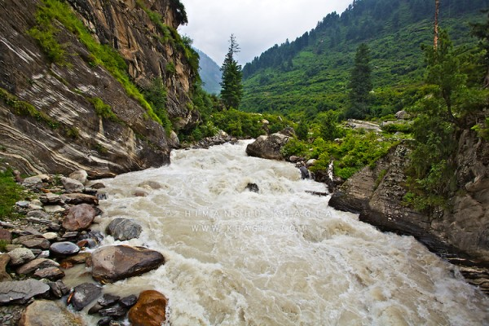
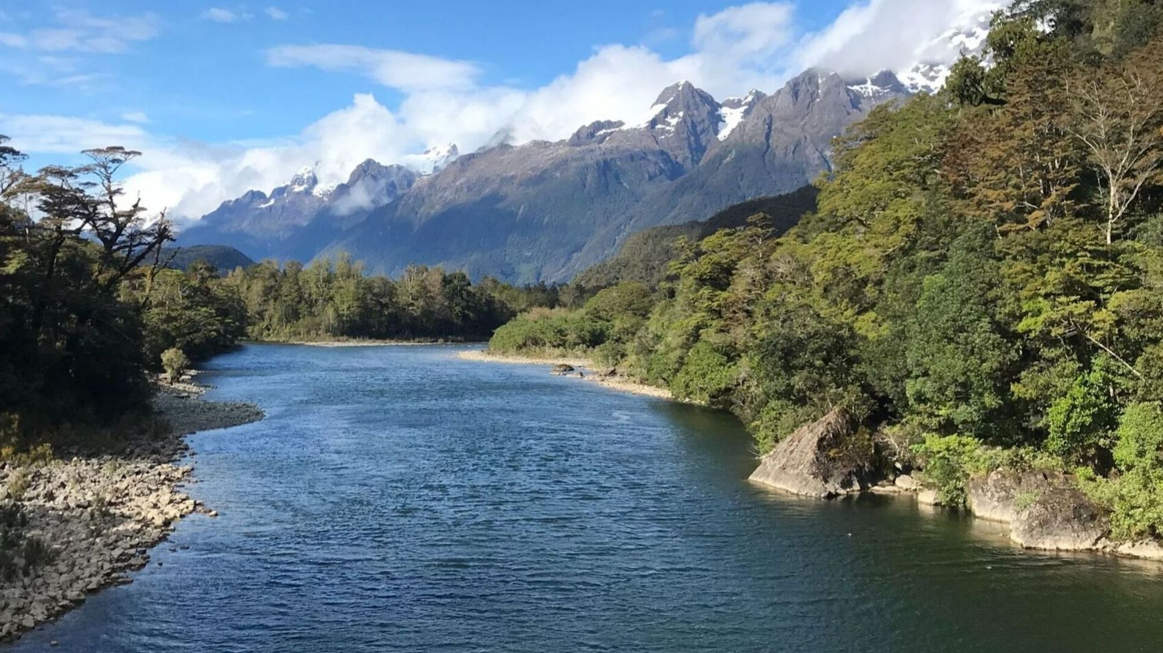
Himalayan river system
They perform an immense erosional activity in the upper course. Brahmaputra and Indus make gorges.
Himalayan rivers are perennial
Carry huge loads of silt and sand

Slide 9
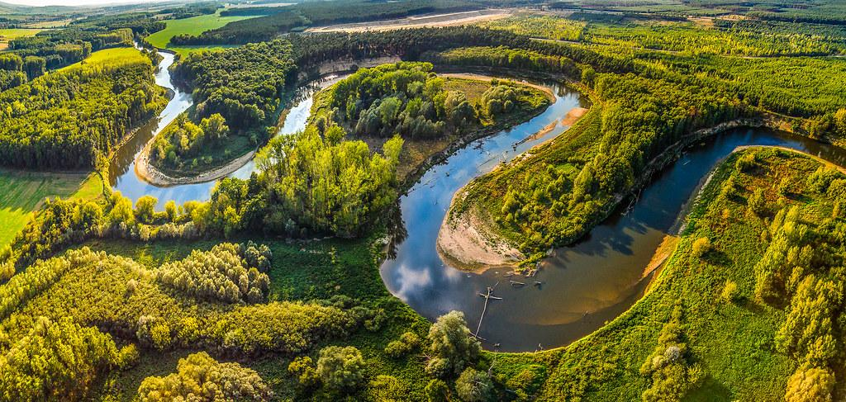
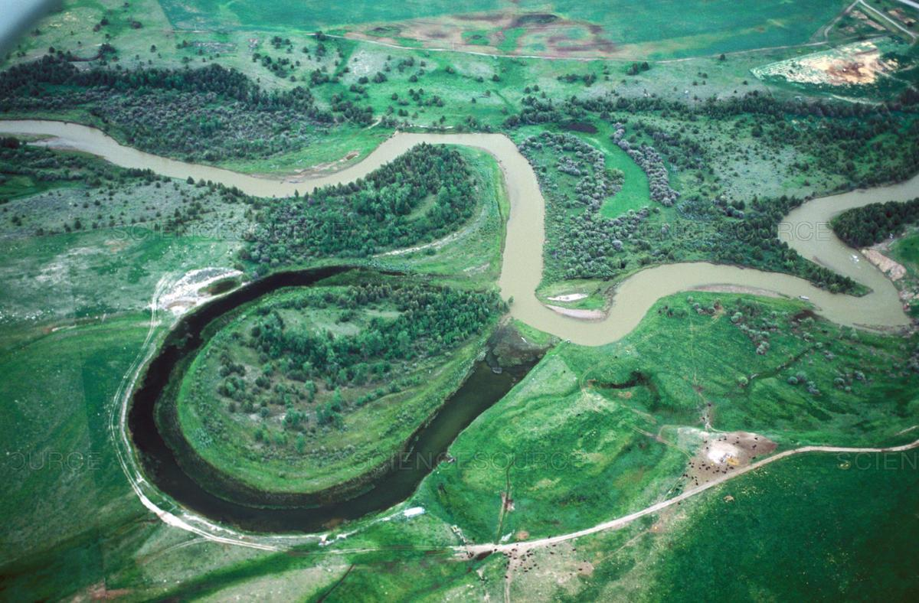
In the middle and lower course they form meanders, oxbow lakes, flood plains and deltas.
Ganga, Indus and Brahmaputra are the major rivers.

Slide 10
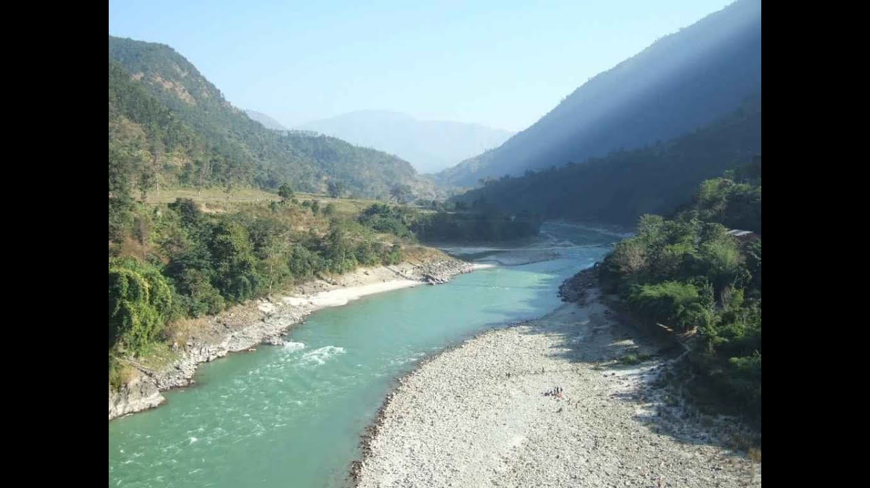
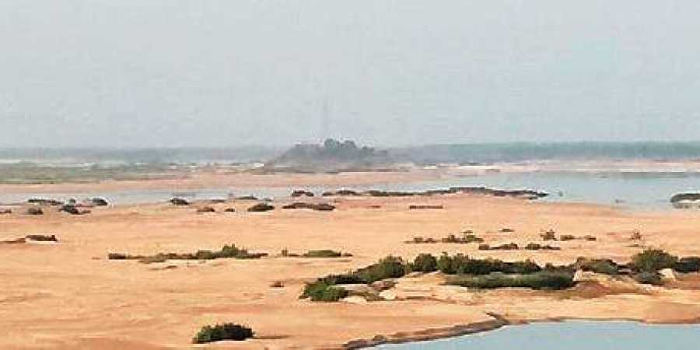
Peninsular rivers
They are seasonal and depend on rainfall
Has short and shallower course
Less erosional activities in upper course.
During dry season it has reduced flow of water.

Slide 11
Do not carry much silt, so there are no major plains. Land is fertile only in delta areas.
The Narmada and Tapi originate in Central Highland and flows towards Arabian Sea.
The Mahanadi, Godavari, Krishna and Kaveri originate in western Ghats and flows towards Bay of Bengal.

Slide 12
A river has 3 stage-- Upper course, Middle course and lower course

Slide 13
Drainage Pattern
There are 4 types of drainage pattern
The streams within a drainage basin form certain patterns, depending on the slope of land, underlying rock structures as well as the climatic conditions of the area
1. Dendritic pattern
2. Trellis pattern
3. Rectangular pattern
4. Radial pattern

Slide 14
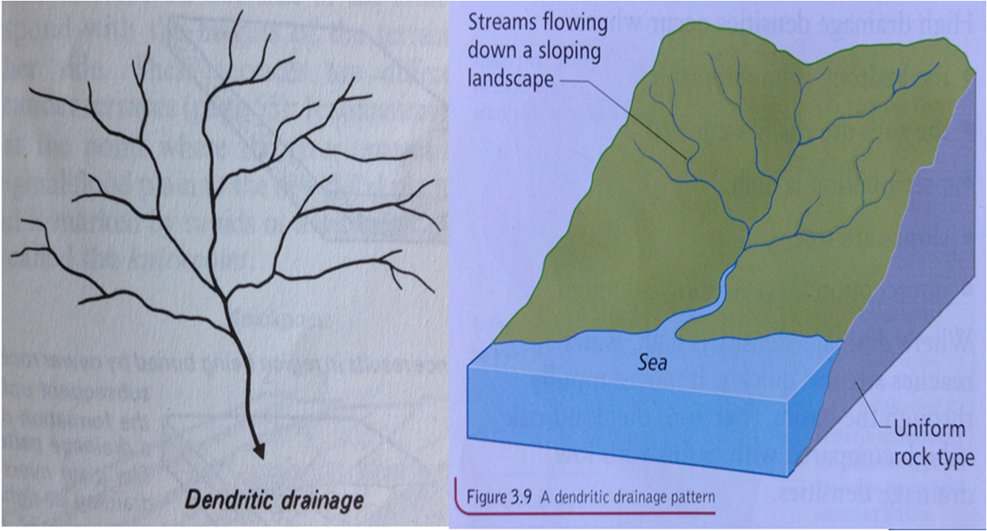
Dendritic pattern
Develops where the river channel follows the slope of the land.
The streams and its tributaries resembles the branches of a tree

Slide 15
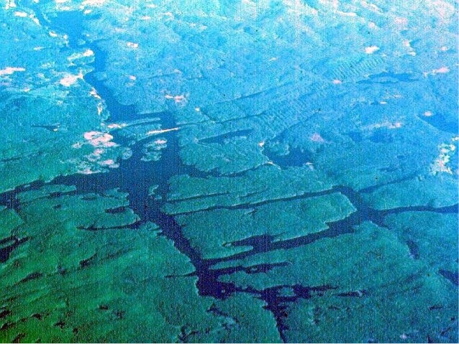
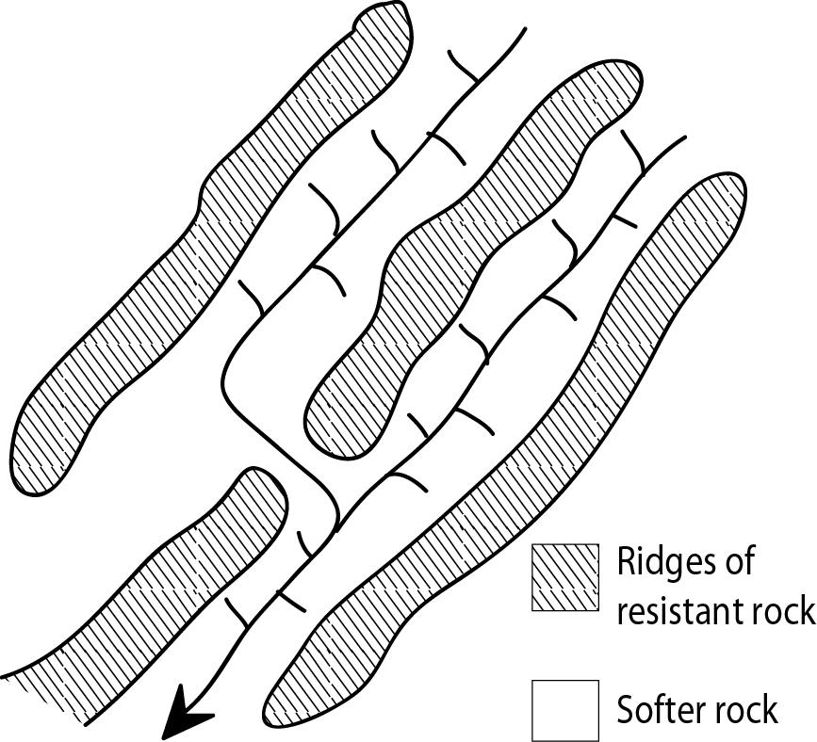
Trellis pattern
A river joined by its tributaries, at approximately right angles, develop a trellis pattern.

Slide 16
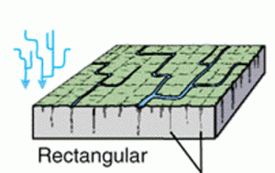
Rectangular Pattern
A rectangular drainage pattern develops on a strongly jointed rocky terrain.

Slide 17
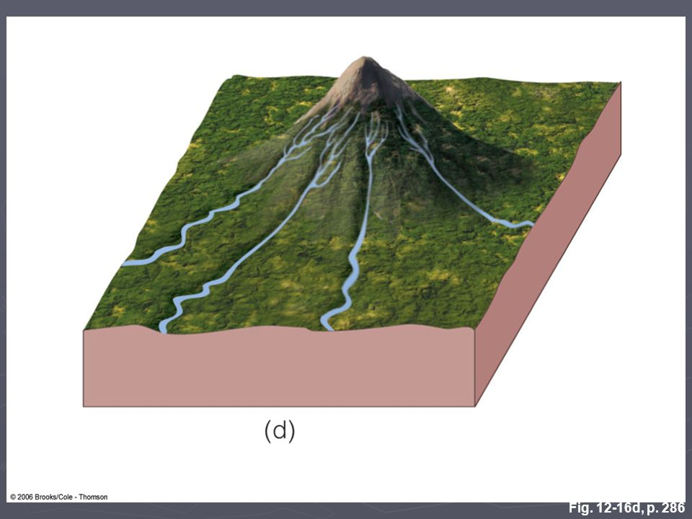
The radial pattern develops when streams flow in different directions from a central peak or dome like structure.
Radial pattern

Slide 18
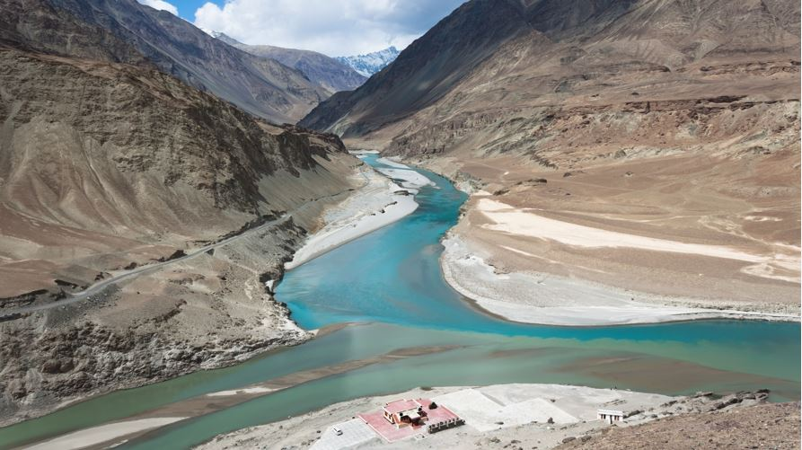
The Himalayan Rivers
A river along with its tributaries may be called a river system.
The major Himalayan rivers are the Indus, the Ganga and the Brahmaputra.

Slide 19
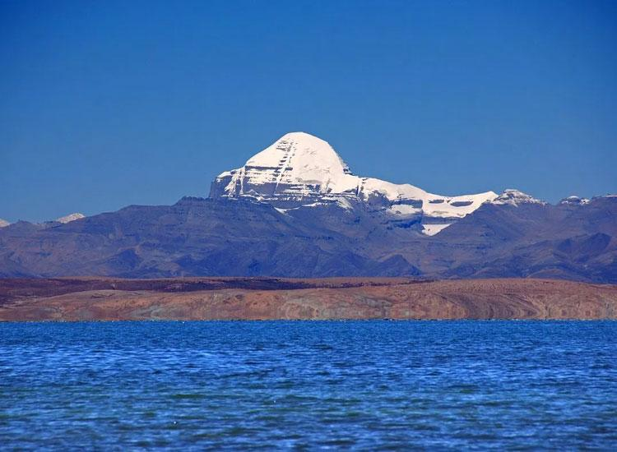
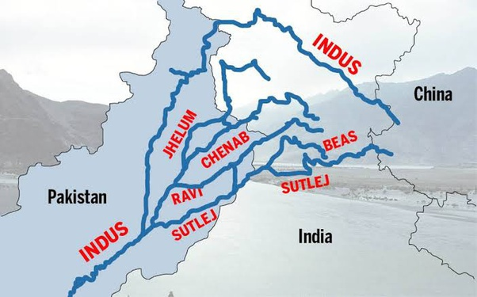
Indus river system

Slide 20
Total length is 2900 kms, originates near Manasarowar lake in Tibet.
The other tributaries are the Satluj, the Ravi, the Beas, the Jhelum and the Chenab joins Indus at Mithankot in Pakistan.
Drains into Arabian sea of Karachi forming a delta
Its important tributaries in Jammu and Kashmir are the Zaskar, Nubra, Shyok and the Hunza.

Slide 21
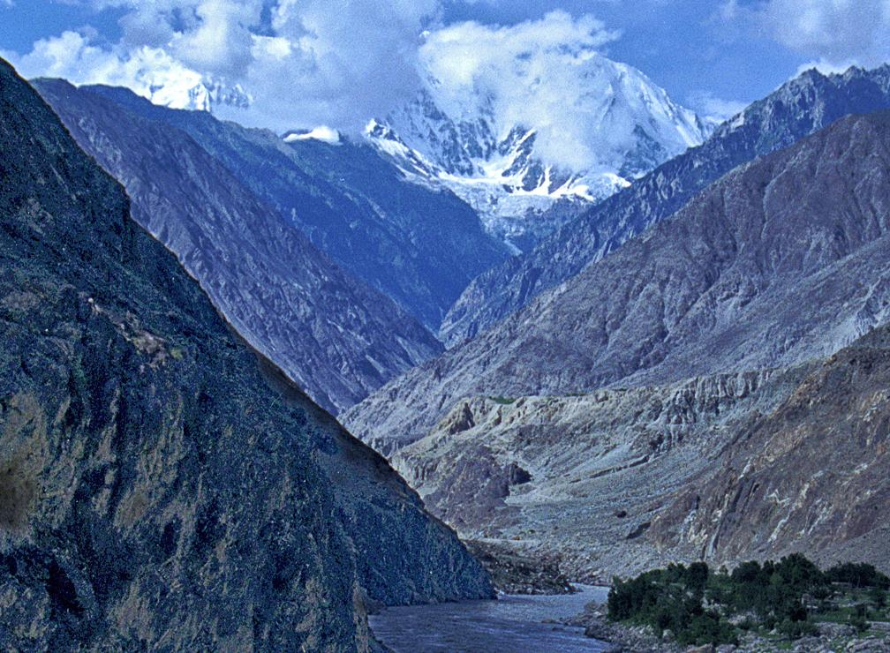
One third of the Indus basin is located in India in the Union territories of Ladakh and Jammu and Kashmir, and in the states of Himachal Pradesh and the Punjab.

Slide 22
According to the regulation of Indus Water Treaty (1960) with Pakistan, India can use only 20% of the total water carried by Indus river system.
This water is used for irrigation in the Punjab, Haryana and the Rajasthan.

Slide 23
Ganga River system

Slide 24
Gaumukh- origin of Ganga

Slide 26
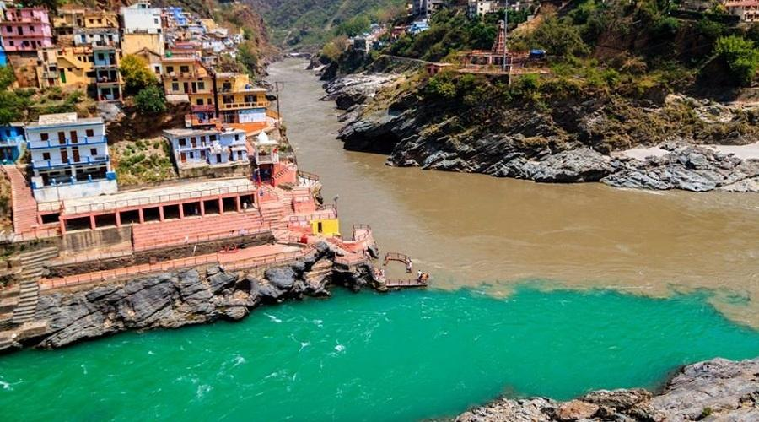
The Ganga river system
Total length is 2500 kms.
The headwaters of the Ganga, called the ‘Bhagirathi is fed by the Gangotri Glacier and joined by the Alaknanda at Devaprayag.

Slide 27
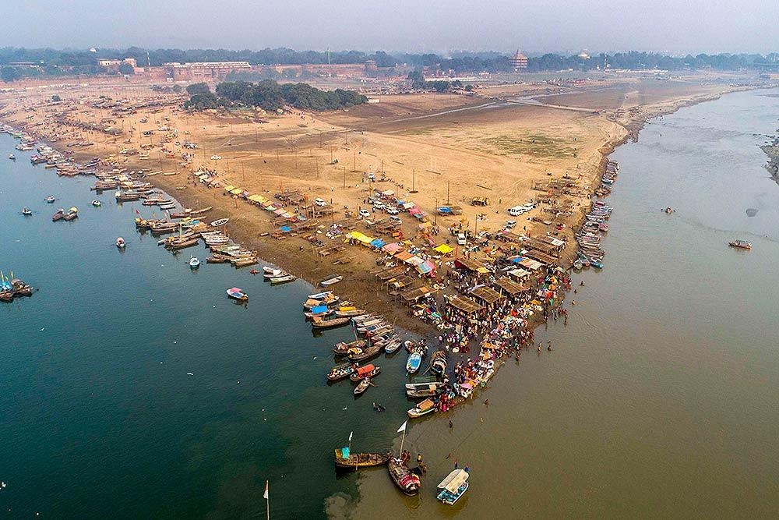
The Yamuna, Ghaghara, Gandak and Kosi are the major tributaries from Himalayas.
The river Yamuna rises from the Yamunotri Glacier and meets the Ganga at Prayagraj.

Slide 28
The main tributaries, which comes from the peninsular uplands, are the Chambal, the Betwa and the Son.

Slide 29
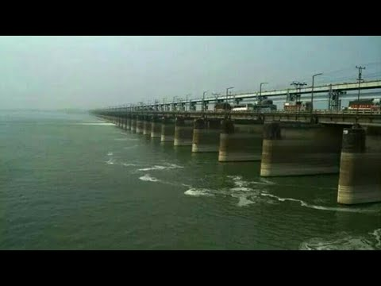
At Farakka in West Bengal, the Ganga enters into Bangladesh.

Slide 30
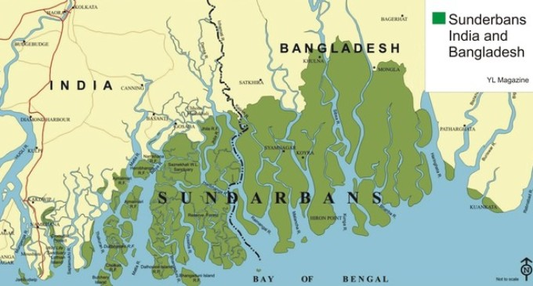
Together they form the largest delta in the world called ‘Sunderban delta’.
It joins with Brahmaputra and known as Meghna.

Slide 31
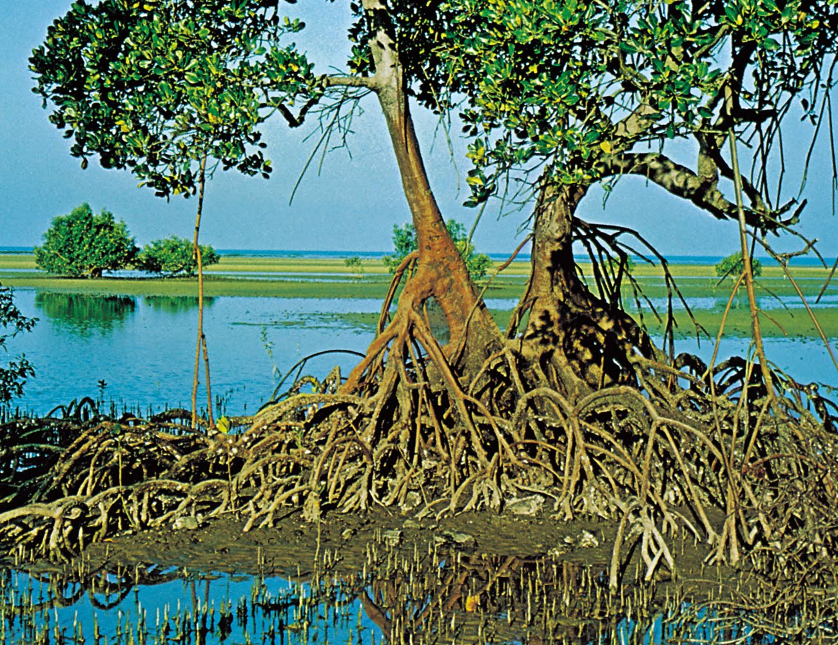
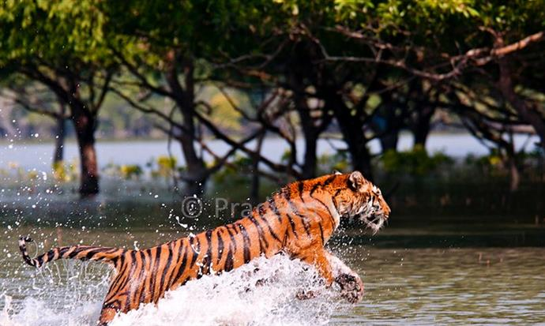
The Sundarban delta derived its name from the Sundari tree which grows well in marshland.
It is the world’s largest and fastest growing delta. Its home to ‘Royal Bengal Tiger’.

Slide 32
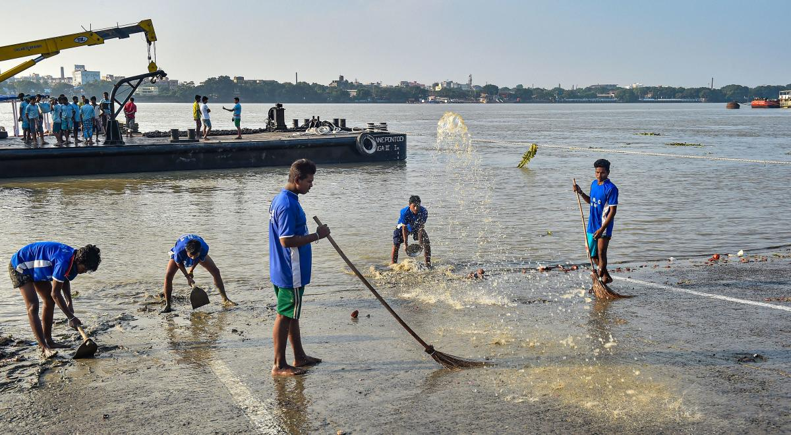
The Namami Gange Progamme
Ganga conservation programme started by Union government in 2014 with two objective.
1. Effective abatement of population
2. Conservation and rejuvenation of the national river.

Slide 33
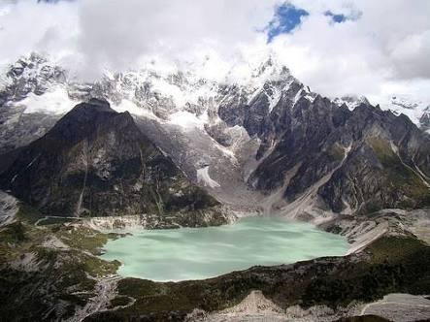
Brahmaputra River System

Slide 34
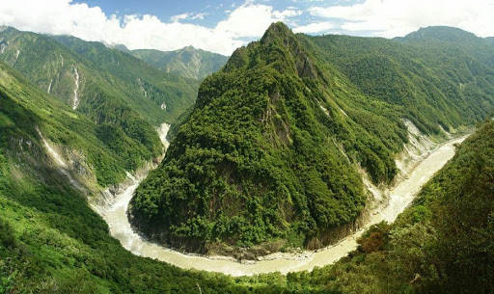
At Namcha Barwa it takes a U-turn to enter India in Arunachal Pradesh through a Gorge. In Arunachal Pradesh it is called Dihang.
Rises in Tibet east of Mansarowar lake.
Dibang and the Lohit are its important tributaries.

Slide 35
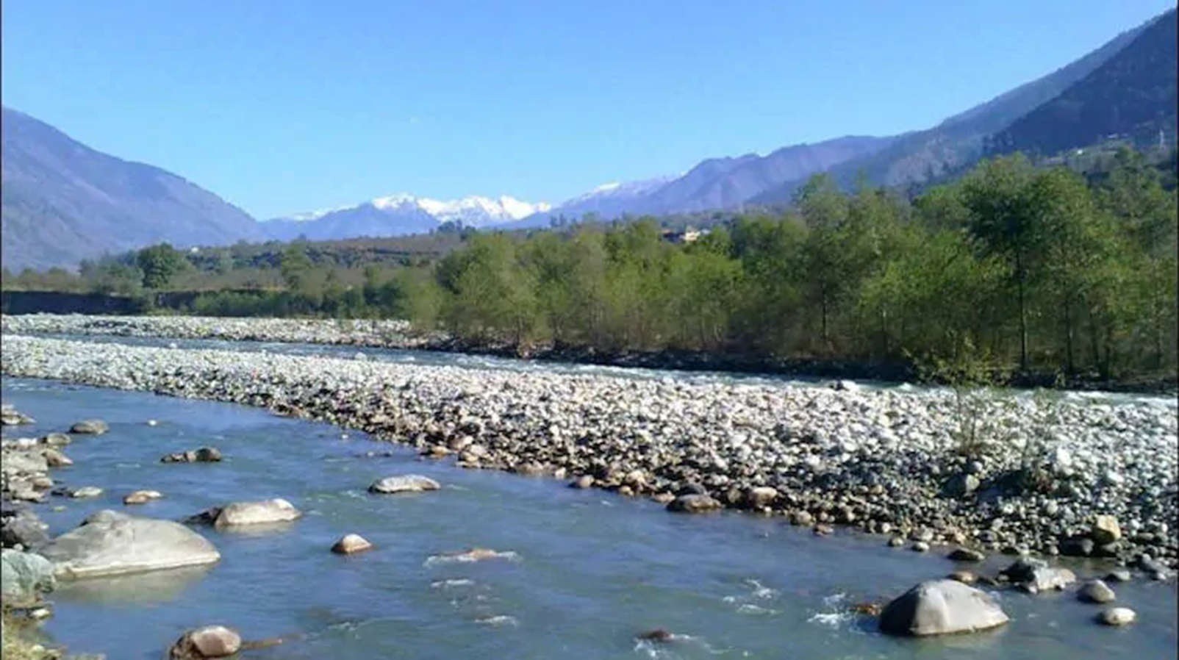
In Tibet, the river carries a smaller volume of water and less silt as it is a cold and a dry area.

Slide 36
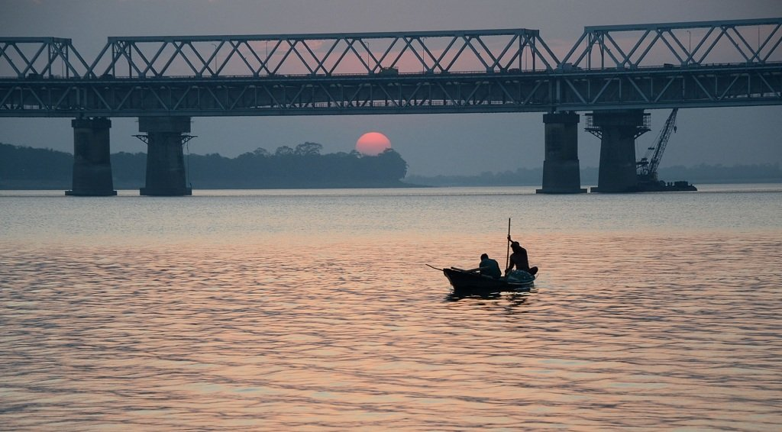
In India it passes through a region of high rainfall, carries a large volume of water and silt.

Slide 37
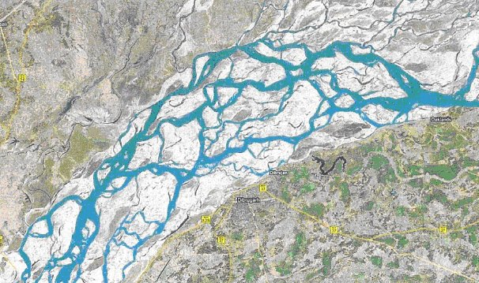
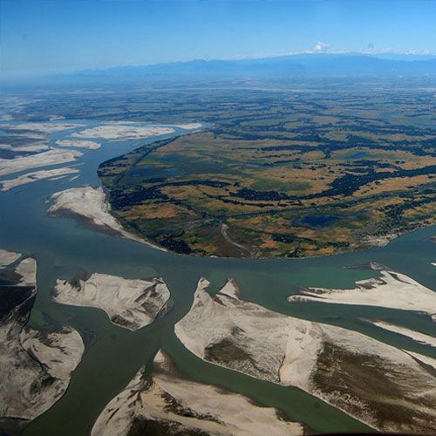
The Brahmaputra has a braided channel in its entire length in Assam and forms many riverine islands.
Majuli is the largest riverine island in the world.

Slide 38
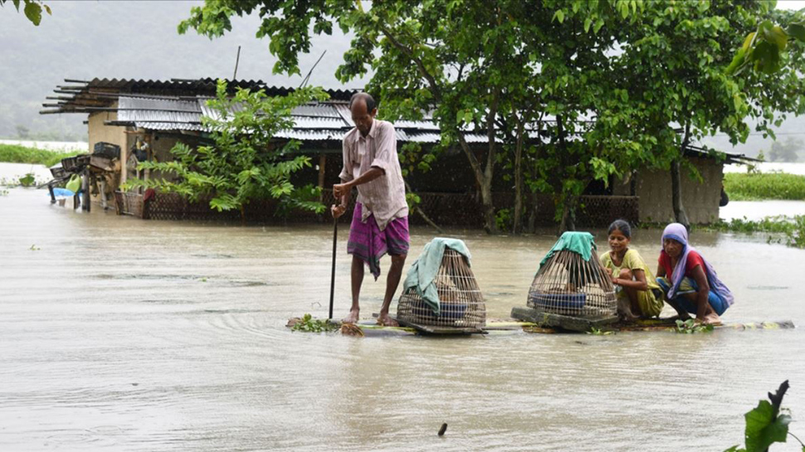
Every year it causes devastating flood in Assam.

Slide 39
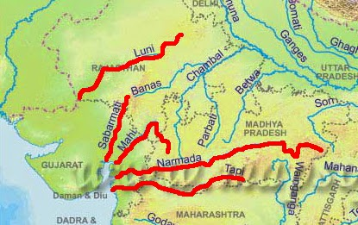
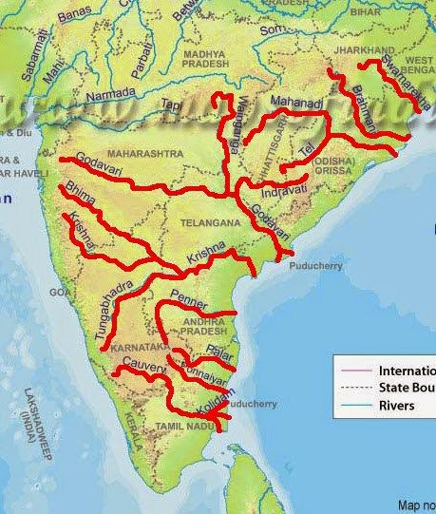
Peninsular rivers
West flowing
East flowing

Slide 40
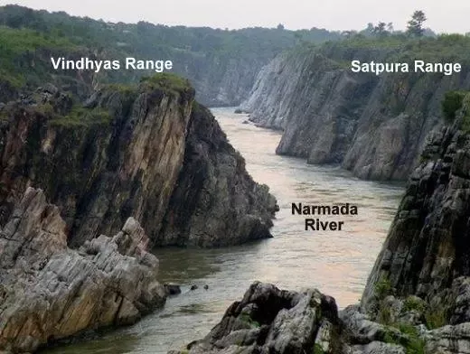
The Narmada Basin
Narmada rises in the Amarkantak hills in Madhya Pradesh.
Flows west in a rift valley formed due to faulting.

Slide 41
Dhuadhar falls

Slide 42
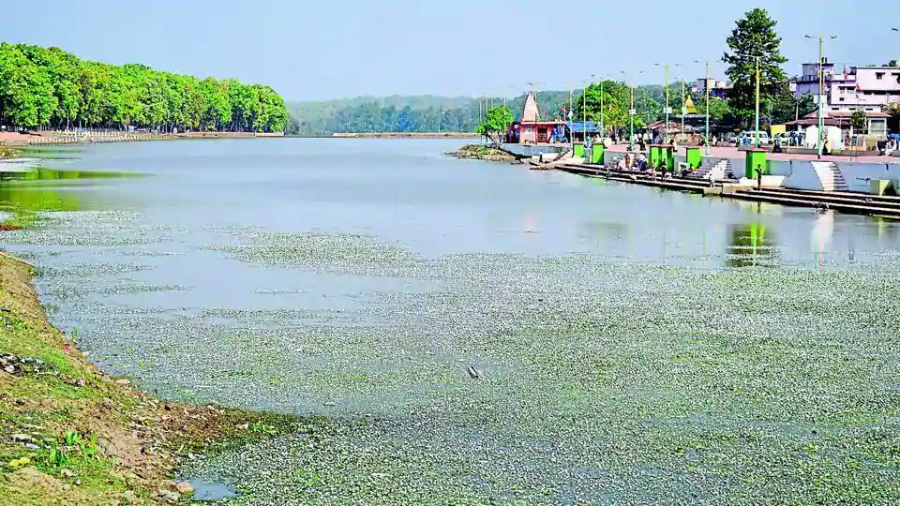
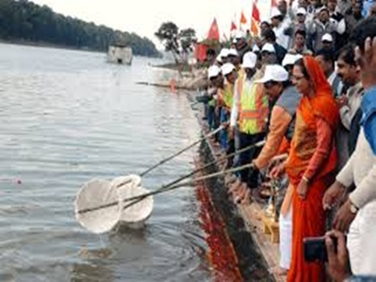
Namami Devi Narmade

Slide 43
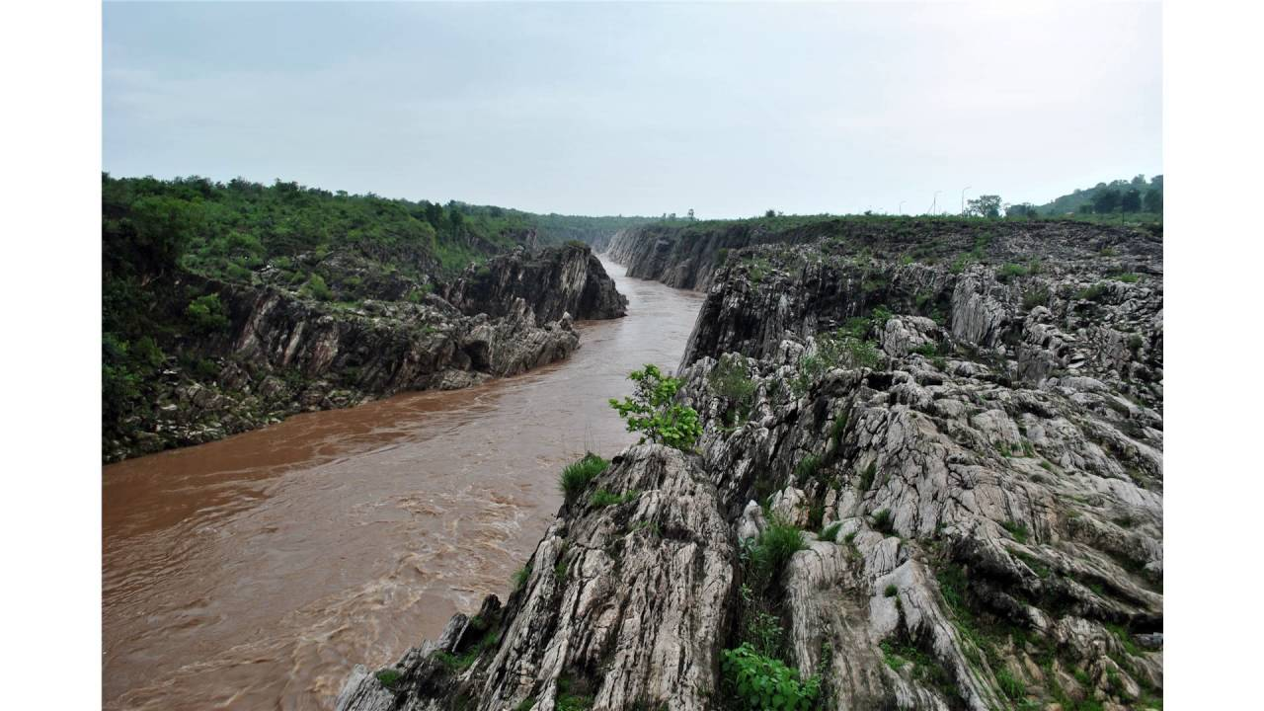
The Tapi basin
The Tapi rises in the Satpura ranges in the Betul district of Madhya Pradesh
It also flows parallel to a rift valley to the Narmada

Slide 44
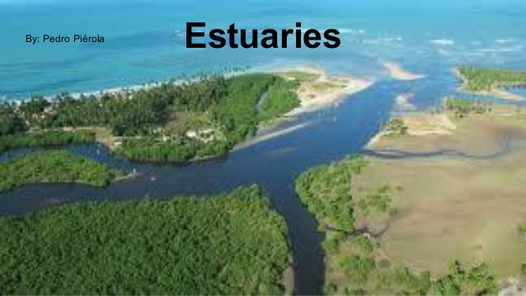
Estuary
Narmada and Tapi do not form delta, their water directly enters into the sea called Estuary.

Slide 45
The Godavari
Largest peninsular river.
Total length is 1500 km.
Rises in the Nasik district of Maharashtra.

Slide 46
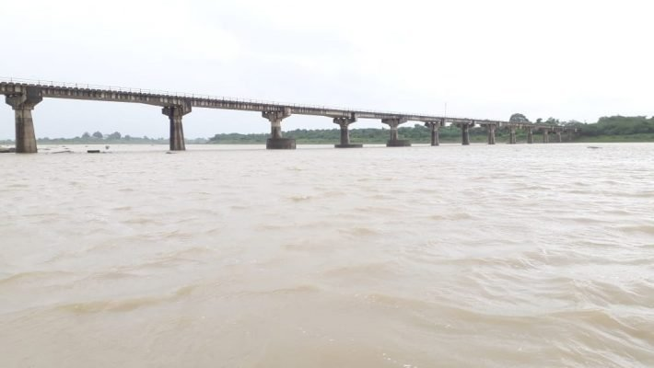
Because of the length and the area Godavari covers, it is also known as the ‘Dakshina Ganga’.

Slide 47
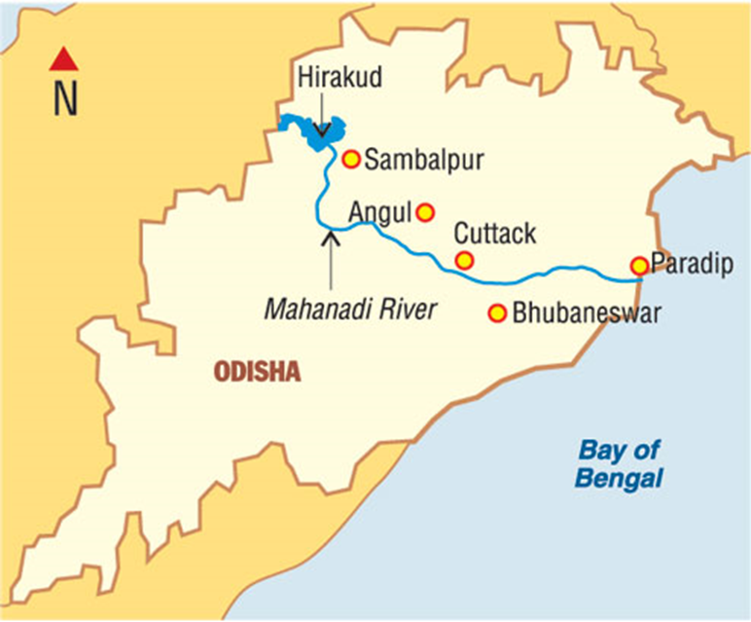
The Mahanadi
Total length is 860 km.
Rises in the highlands of Chhattisgarh.

Slide 48
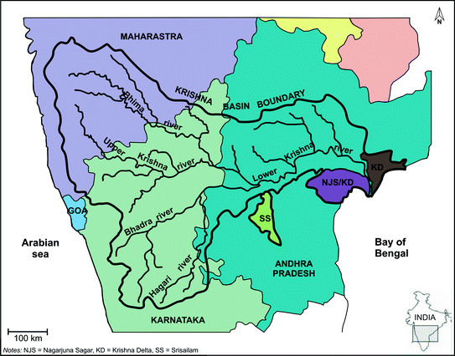
The Krishna
Rise from a spring near Mahabaleshwar, the Krishna flows for about 1400 km.
The Tungabhadra, the Koyana, the Ghatprabha, the Musi and the Bhima are some of its tributaries.

Slide 49
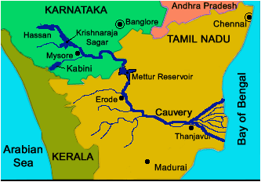
Rises in the Brahmagiri range of the Western Ghats.
The Kaveri
Amravati, Bhavani, Hemavati and Kabini are its important tributaries.
Total length is 760 km.

Slide 50
River Kaveri makes the second biggest waterfall in India- Sivasamudram

Slide 51
Jog falls is the biggest waterfall in India.

Slide 52
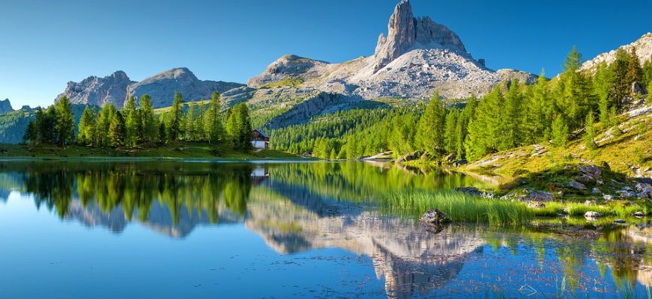
A body of water that lies in a hollow in the earth’s surface and is surrounded by land.
Lakes

Slide 53
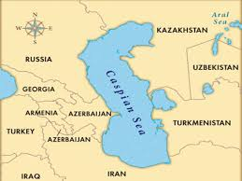
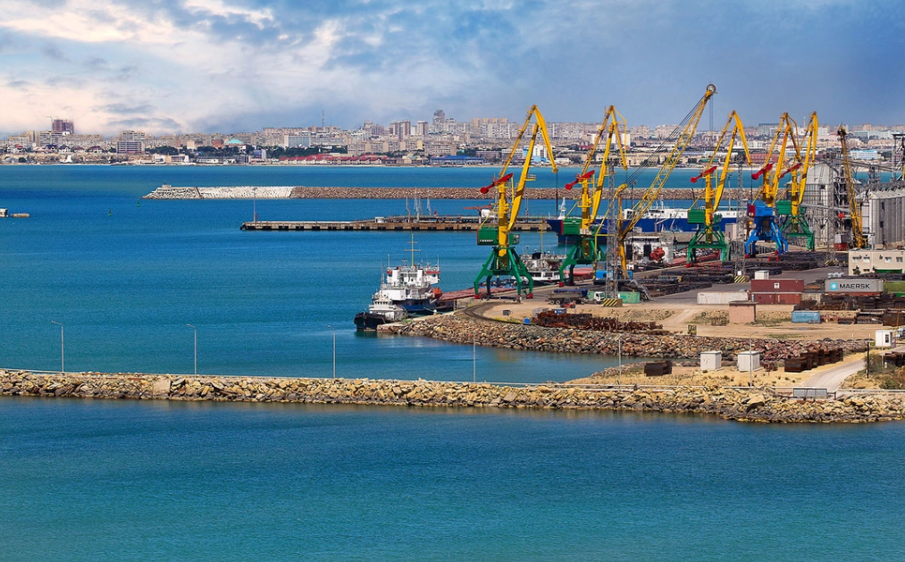
Lakes of large extent are called the seas, like the Caspian, the Dead sea and the Aral sea.

Slide 56
Lakes can be classified as Salt water lake and Fresh water lake or natural lake and man-made lake.
Lakes are formed by the actions of glacier, wind, river action and human activities.

Slide 57
A meandering river across a flood plain forms cut-offs that later develop into ox-bow lakes.

Slide 58
Spit and bars form lagoons in the coastal areas, eg the Chilika lake, the Pulicat lake , the Kolleru lake.

Slide 59
Lakes in the region of Inland drainage are sometimes seasonal, for example, the Sambhar lake in Rajasthan, which is a salt water lake.

Slide 60
Wular lake in Jammu and Kashmir, is a result of tectonic activity

Slide 61
Dams across rivers has led to the formation of lakes called man-made lakes. Example – Guru Gobind Sagar (Bhakra Nangal project)

Slide 62
Importance of lakes
Prevents flooding during rainy season.
Regulates the flow of a river.
Maintains even flow of water

Slide 63
Used for developing hydel power.
Influence the climate of the surrounding.
Enhance natural beauty, develops tourism.
Maintains aquatic ecosystem.

Slide 64
Role of rivers in the economy
Rivers have attracted human settlement from ancient times.
Today these settlements have become large cities.
Used for irrigation, navigation and hydro power generation.

Slide 65
River Pollution
The growing domestic, municipal, industrial and agricultural demand for water from rivers naturally affects the quality of water.

Slide 66
Heavy load of untreated sewage and industrial effluents are emptied into the river causing pollution.

Slide 67
Urbanisation and industrialisation has also contributed to the river pollution.

Slide 68
Thank You

