Slide 1
Rithesh.k, Grade-6A

Slide 2
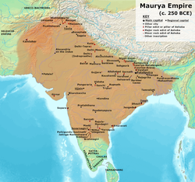
Introduction
Mauryas – established the first ever empire in India
Larger than kingdom and spread over a vast area
Controlled more land than previous dynasty

Slide 3
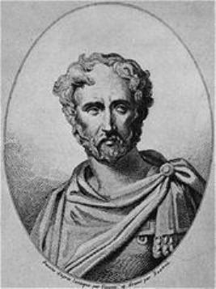
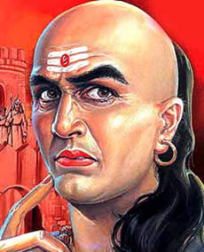
Sources of Information
Two books
Indika by Magesthenes
Indika – tells about the political social and economic Condition during that period
Ambassador of Seleucus Nicator and Lived in court of Chandragupta
Arthashastra by Kautilya
It deals with how to govern an empire and describes the administration of the Mauryas

Slide 4
Mauryan Emperors

Slide 5
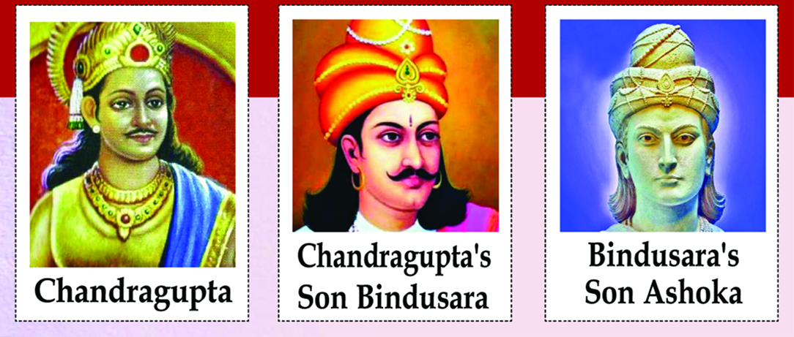
Chandragupta Maurya (321 – 297 BCE)
Bindusara (297 – 273 BCE)
Ashoka (273 – 232 BCE)

Slide 6
Chandragupta Maurya (321 – 297 BCE)
First ruler of Dynasty and last Nanda ruler in 321 BCE
Supported by his minister Chanakya – known as Kautilya or Vishnugupta
First conquered Magadha
Defeated Seleucus Nicator- General of the Greek King Alexander
Strengthen his control over other parts of northern India

Slide 7
Bindusara (297 – 273 BCE)
Also called Bindusara Maurya, Greek Amitrochates, born 320 BCE—died 272 BCE
Second Mauryan emperor , who ascended the throne about 297 BCE.
Greek sources refer to him as Amitrochates, Greek for the Sanskrit amitraghata refers to destroyer of foes.
He defeated rulers of 16 kingdoms and added their land to his empire.
Under him the Mauryan empire spread across the whole Indian subcontinent.

Slide 8
Ashoka 273-232 BCE
Popularly known as Ashoka the Great, was the 3rd Mauryan Emperor of the Mauryan Empire of India during 268 to 232 BCE.
The war to occupy Kalinga was considered the bloodiest and most lethal that Emperor Ashoka had ever waged.
The massive loss of lives and damage left him shattered and regretful, which ultimately caused him to transform from a fierce and vengeful ruler to a peaceful and benevolent emperor.
He is said to have constructed approximately 84,000 stupas and pillars across his empire during his lifetime.

Slide 9
Ashoka’s Dhamma
Ashoka pleaded for tolerance of different religious sects in an attempt to create a sense of harmony.
The policy of Dhamma also laid stress on non-violence, which was to be practiced by giving up war and conquests and also as a restraint on the killing of animals.
The principles of Dhamma were formulated to be acceptable to people belonging to different communities and following any religion.

Slide 10
Principles of dhamma
Ashoka wanted his subjects to follow such a Dhamma that maybe based on the unifying principles of all major religions of the world. Ashoka's Dhamma has the following salient points:
Respect to elders and love to children.
Ahimsa or non-violence.
Good deeds would give happiness to man in the next birth.
He taught people to respect all religions.
He disapproved empty rituals.

Slide 11
Spread of dhamma
He appointed Dhamma mahamattas, who went from place to place teaching people about Dhamma.
Ashoka also used inscribed rock pillars to spread his message of Dhamma.
He also sent messengers to spread the message of Dhamma Ashoka's dhamma was neither a new religion nor a new political philosophy.
Rather, it was a way of life, a code of conduct and a set of principles to be adopted and practiced by the people at large. other countries like Syria, Egypt, Greece and Srilanka.

Slide 12
Administration
Mauryan administration was highly centralized. The Emperor was the supreme power and source of all authority.
He was assisted by a Council of Ministers. It was called 'Mantriparishad'. The ministers were called ‘Mantris.’
The council was headed by ‘mantriparishad-adhyakshya’ akin to the Prime Minister of today.
Tirthas: the Highest category of officials in the administration. There were 18 Tirthas.
Adhyakshya: Ranked next only to Tirthas. There were 20 Adhyakshyas. They had economic and military functions.
Mahamattas: Higher ranking officials.
Amatyas: High ranking officials almost like present-day secretaries. They had administrative and judicial roles.
The Adhyakshyas were formed into a secretariat, which was divided into many departments.

Slide 13
Thank You

