Slide 1
English
Grade IV
Sreenithi. S

Slide 2
Simple present tense
The simple present is a verb tense with two main uses. We use the simple present tense when an action is happening right now, or when it happens regularly. Depending on the person, the simple present tense is formed by using the root form or by adding ‑s or ‑es to the end.
First-person singular: I write
Second-person singular: You write
Third-person singular: He/she/it writes (note the ‑s)
First-person plural: We write
Second-person plural: You write
Third-person plural: They write

Slide 4
Simple continuous tense
Present continuous tense can be used to express something happening right now or to express something that is not happening right now.
Example :
He is not standing.
Anthony is sitting in the chair.
You are not watching the movie.
Rose is reading a book.

Slide 5
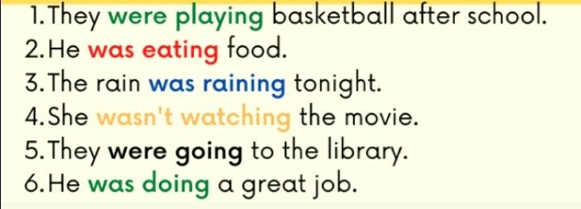

Slide 6
Thank you

