Slide 1
ICT

Slide 2
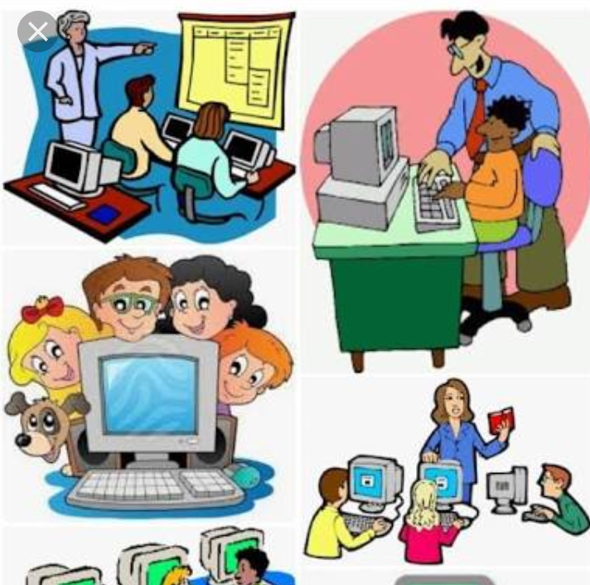

Slide 3
WHY ICT?
You can search for the information you need.
As children you are responsible for your own learning.
It will create independent learners.
It includes the internet, wireless networks, cell phones, computers, software, video-conferencing and services ...

Slide 4
1. A SMART MACHINE
The computer - a Machine.
It needs electricity to work.
It’s called as Electronic Machine.

Slide 5
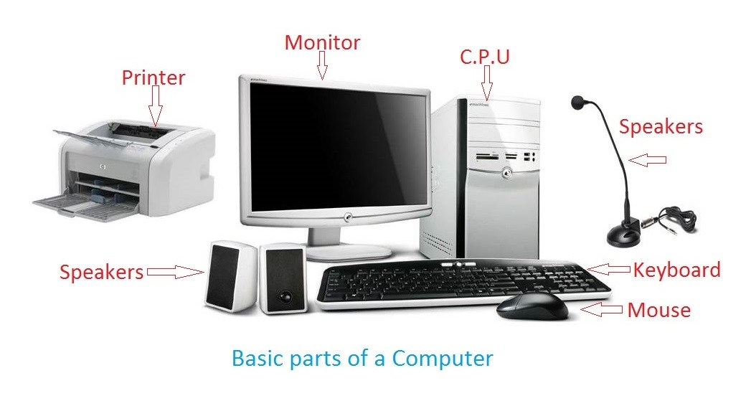
PARTS OF COMPUTER

Slide 6
USES OF COMPUTERS
Music
Movies
Type
Play games
Draw
Solve sums

Slide 7
HUMANS AND COMPUTERS
COMPUTER
HUMAN
It can work very fast.
Does not make a mistake.
Never gets tired.
Never gets bored.
It has very good memory.
Does not have feelings and cannot take decisions.
Human cannot work very fast as a computer.
Human can make mistakes.
Do get tired after sometime.
We may sometimes get bored.
Humans can forget the information stored in their minds.
We have feelings and we can take decisions.

Slide 8
THANK YOU

