Slide 1
ANIMALS

Slide 11
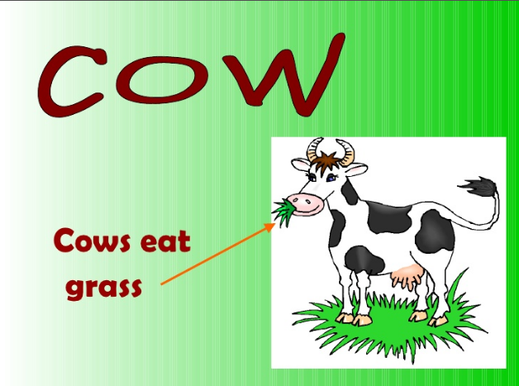

Slide 14
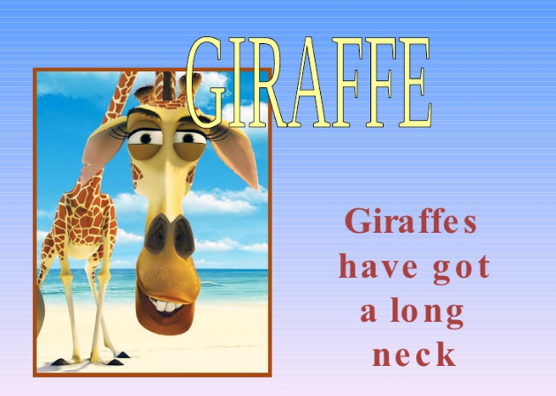

Slide 22
THANK YOU

