Slide 1
FRUITS

Slide 2
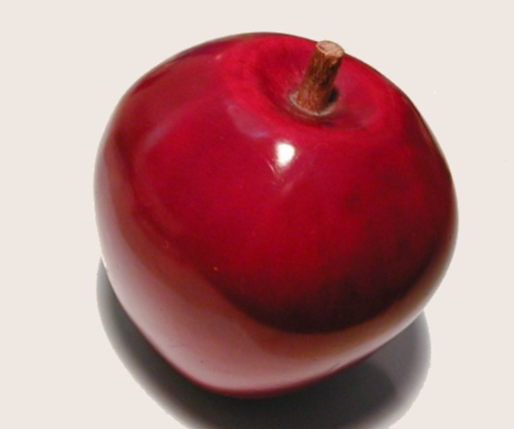
APPLE

Slide 3
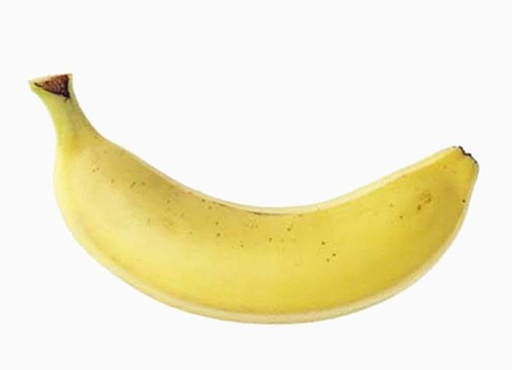
BANANA

Slide 4
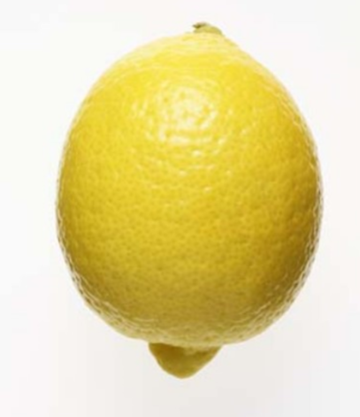
LEMON

Slide 5
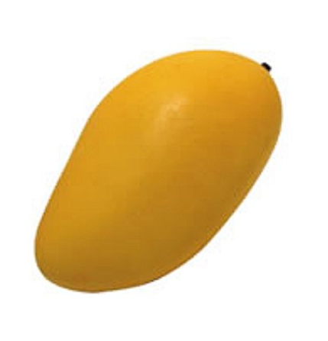
MANGO

Slide 6
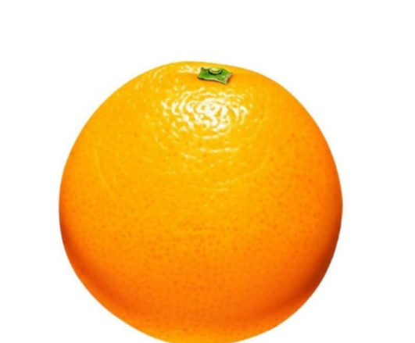
ORANGE

Slide 7
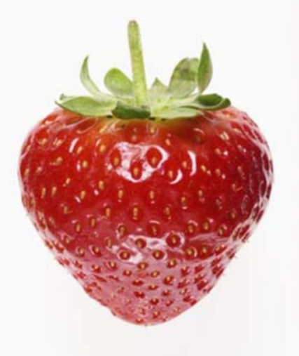
STRAWBERRY

Slide 8
THANK YOU

