Slide 1
COUNTING

Slide 2
ONE

Slide 3
TWO

Slide 4
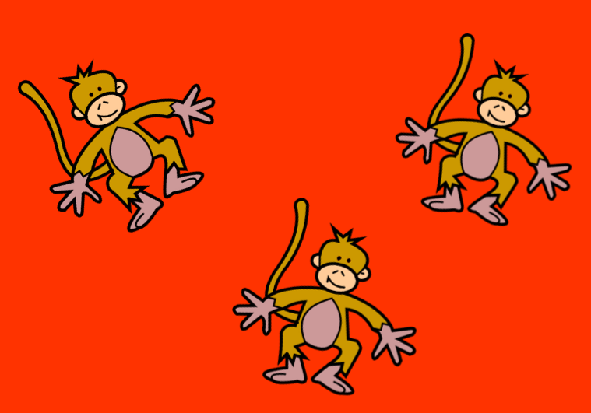
THREE

Slide 5
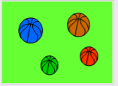
FOUR

Slide 6
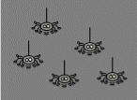
FIVE

Slide 7
SIX

Slide 8
SEVEN

Slide 9
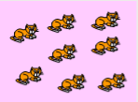
EIGHT

Slide 10
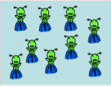
NINE

Slide 11
TEN

