Slide 1
COMPUTER MEMORY

Slide 2
What is computer memory ?
Computer memory is the storage space where data is to be processed, and instructions needed for processing are stored.

Slide 3
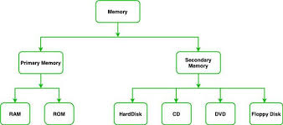
TYPES OF COMPUTER MEMORY

Slide 4
